Slide 2
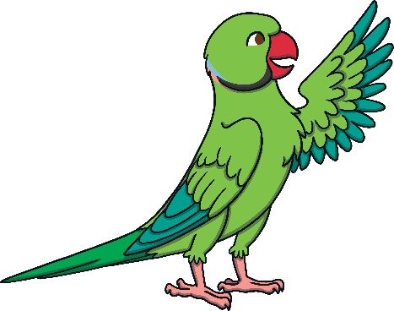
What can you hear?
Well done!

Slide 3
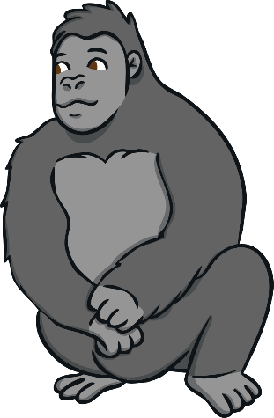
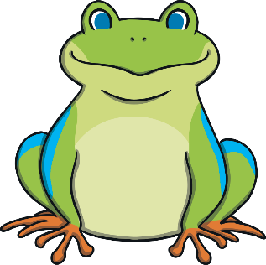
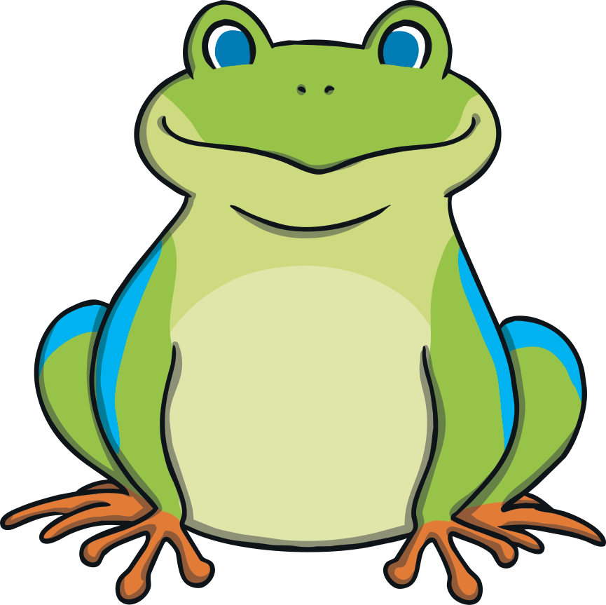
What can you hear?
Well done!

Slide 4
What can you hear?
Well done!

Slide 5
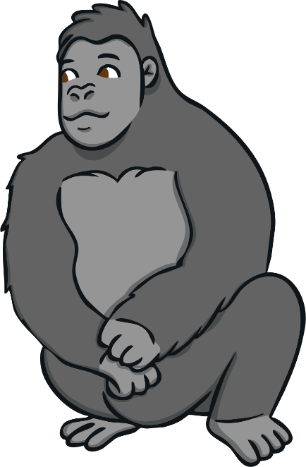
What can you hear?
Well done!

Slide 6
What can you hear?
Well done!

Slide 7
What can you hear?
Well done!

