Slide 1
Subject: English Year Group:1 Week Commencing: 18/5/20
For subject information, games and activities to support this planning, please also look on the ‘Help your child with English’ document saved on the class page.

Slide 2
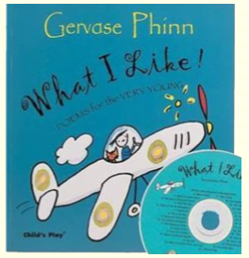
Date:18/5/20 Lesson Objective: To draft your first ‘Noises off’ stanza.
Activity:
Today you are going to be looking back at your notes from last week from your first place you chose to write your ‘Noises off’ stanza about.
Read back through your notes, thinking about which words are the noun and which words are the verbs.
Think about how you are going to organise your ideas- what order would you like to write the nouns?
Task
You are going to do a ‘first draft’ of your stanza. Don’t forget to include a title ‘The _______ full of noises’.
Have a go at writing the noun and then the verb- so you are now linking these two ideas together.
Think about dropping down for a new line for each noun.
*Don’t worry too much about your handwriting or spelling for this draft- you will be writing up your final draft in a few days*.

Slide 3
Date:19/5/20 Lesson Objective: To draft your second ‘Noises off’ stanza.
Activity:
Today you are going to be looking back at your notes from last week from your second place you chose to write your ‘Noises off’ stanza about.
Read back through your notes, thinking about which words are the noun and which words are the verbs.
Think about how you are going to organise your ideas- what order would you like to write the nouns?
Task
You are going to do a ‘first draft’ of your stanza. Don’t forget to include a title ‘The _______ full of noises’.
Have a go at writing the noun and then the verb- so you are now linking these two ideas together.
Think about dropping down for a new line for each noun.
*Don’t worry too much about your handwriting or spelling for this draft- you will be writing up your final draft in a few days*.

Slide 4
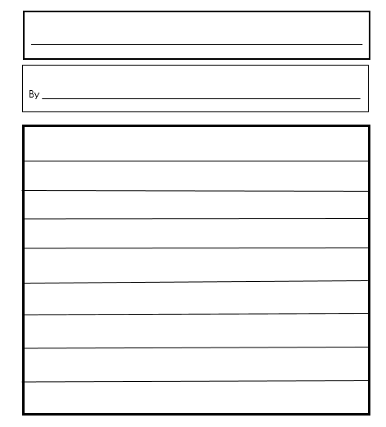
Date:20/5/20 Lesson Objective: To edit and final draft your first ‘Noises off’ stanza.
Title
Activity:
Today you are going to be producing your final draft of your first stanza.
Read back through the draft you made on Monday- say it aloud, are you happy with the order that you have recorded the nouns? Maybe ask someone else to read to you, do you like the way that it sounds? Do you want to change any of the verbs?
You might want to consider moving some of the order of the nouns around if you are not happy with how your poem sounds or using other verbs if you have thought of more exciting ones!
Task- *Final draft of your first stanza. Template available if you want to use it but please used lined paper if not*.
You might want to use a dictionary to check some of your spelling- (we have previously used dictionaries in class before) and you must make sure to correctly include the ‘ing’ at the end of your verb.
Take time to think about your handwriting- ascenders being the tallest letters, descenders dropping under the line, we do not join capital letters. Remember this is your final draft so you want to make it look like it is ready to go into a poetry book!
Add illustrations around your stanza to show either the place you are writing about or some of the nouns that you have mentioned in your poem.

Slide 5
Date:21/5/20 Lesson Objective: To edit and final draft your second ‘Noises off’ stanza.
Title
Activity:
Today you are going to be producing your final draft of your second stanza.
Read back through the draft you made on Tuesday- say it aloud, are you happy with the order that you have recorded the nouns? Maybe ask someone else to read to you, do you like the way that it sounds? Do you want to change any of the verbs?
You might want to consider moving some of the order of the nouns around if you are not happy with how your poem sounds or using other verbs if you have thought of more exciting ones!
Task- *Final draft of your second stanza. Template available if you want to use it but please used lined paper if not*.
You might want to use a dictionary to check some of your spelling- (we have previously used dictionaries in class before) and you must make sure to correctly include the ‘ing’ at the end of your verb.
Take time to think about your handwriting- ascenders being the tallest letters, descenders dropping under the line, we do not join capital letters. Remember this is your final draft so you want to make it look like it is ready to go into a poetry book!
Add illustrations around your stanza to show either the place you are writing about or some of the nouns that you have mentioned in your poem.

Slide 6
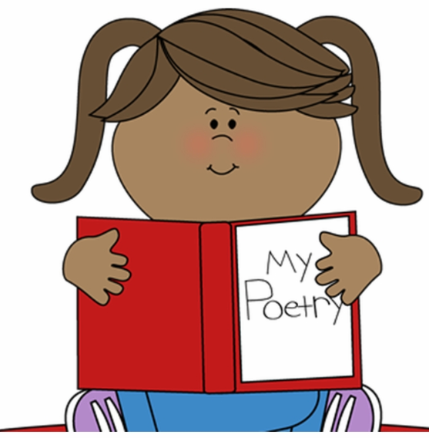
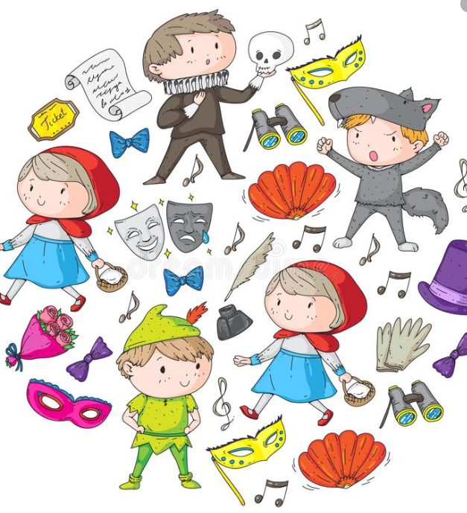
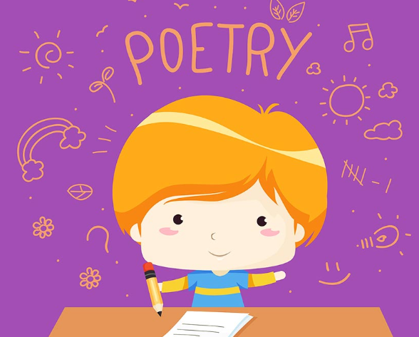
Date:22/5/20 Lesson Objective: To perform your poetry.
Activity:
Today you are becoming poets and performing your poets to others! As-well as performing your poetry to your family at home maybe you might want to face-time/ video call other members of your family or friends and ‘knock their socks off’ with your amazing poetry skills!
When you are performing your poetry think about how you can use your voice to make your poem even more interesting- are there some parts you could say in a quiet voice? Are there others which might be better said in a loud voice? Why might these parts be made more interesting by changing your voice? Practice your poems lot’s of time before you are ready to perform!
Task
A poetry recital! Maybe you could see if your parents can contact any other of the children in your class and you could perform your poems to one another? Maybe your grandparents, Aunties/ Uncles or friends might like to hear your poems?

