Slide 1
Maths – Week 1
Week Beginning 1st June
SESSION 4
This week’s focus: teen numbers

Slide 2
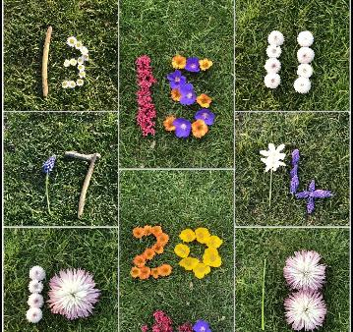
Parent notes
You may have identified certain teen numbers that your child is struggling to remember, count to or match the quantity. (common ones are 13, 15 and 17). Try to focus on these numbers and explore more more/one less than.
For this session we would like your child to make teen numbers using natural objects outside (if this isn’t possible, using objects around the garden or house to fine!
Once they have made the number, can they place that many objects next to their number? See the next slide for ideas.
This should help them with remembering to write the ‘1’ first when writing teen numbers.
Thank you for your ongoing support!

Slide 3
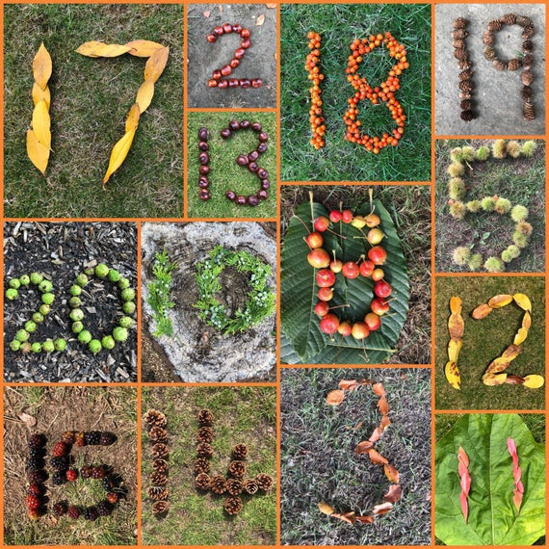
Making teen numbers – use natural objects outside (if possible) and get your child to take a photo of their teen number. The ask them to put that amount of small objects next to the number (see below)
See next slide for an extension to this task

Slide 4
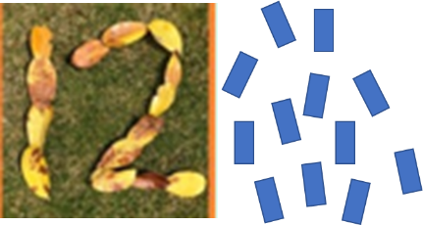
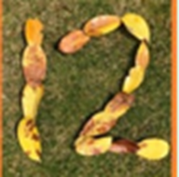
Extension
When using small objects to represent the quantity of the teen number they have made, can they arrange their objects in different ways? The example below is 2 rows of 6 – your child might say they’ve made 2 line… ask them how many is in each line? This will give them an understanding of different ways to make up a given teen number.
Child: “I’ve made 2 lines!”
Parent: “How many in each line?”
Child: “6 in that one, and 6 in that one.” Parent: “So 2 sixes must make what?”
Child: “12!”
Parent: “Well done, can you make 12 in a different way?

