Slide 1
Subject: English Year Group:1 Week Commencing:1/6/20
For subject information, games and activities to support this planning, please also look on the ‘Help your child with English’ document saved on the class page.

Slide 2
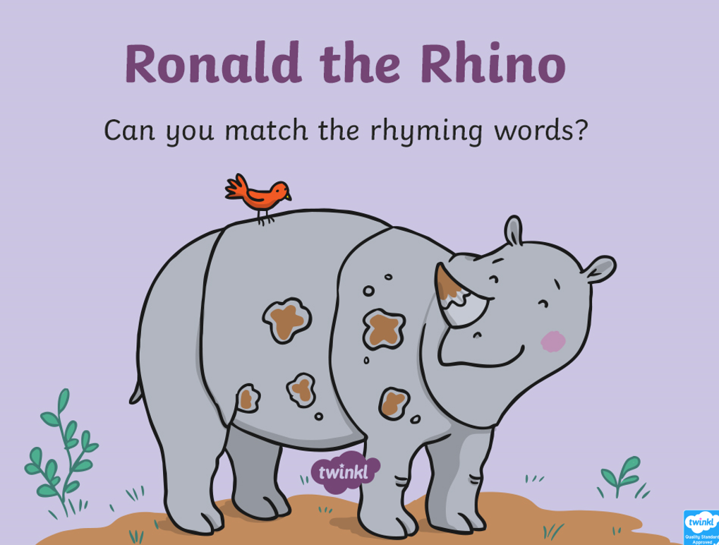
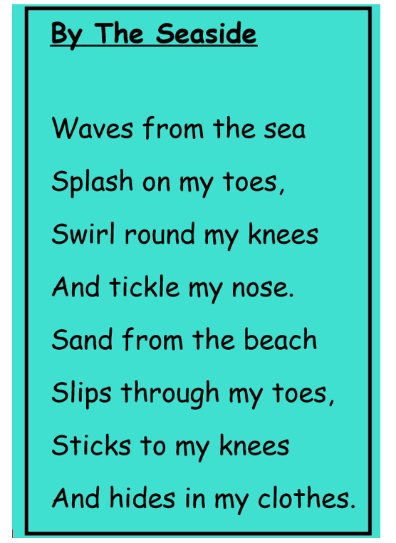
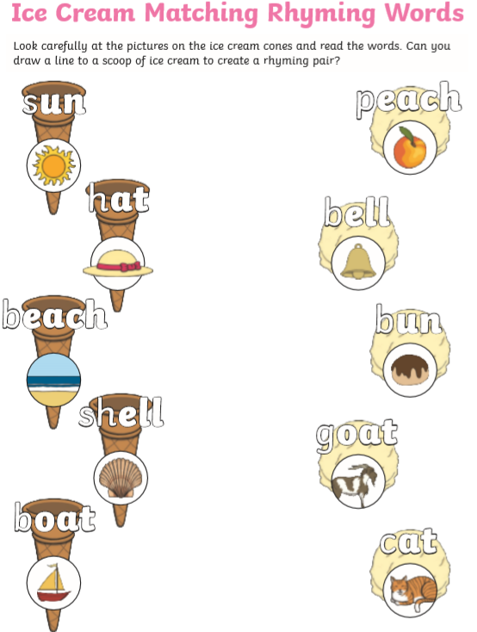
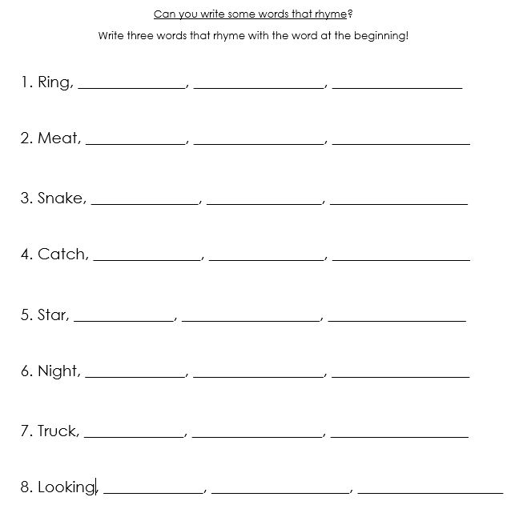
Date:1/6/20 Lesson Objective: To understand and use rhyming words.
Activity: We are continuing on our English unit on Poetry. Some poets choose to use rhyme in their poems; some poets do not.
Today we are going to be revisiting and exploring rhyming words. Use the Ronald the Rhino rhyming power-point (1.Rhyming PowerPoint) to refresh and practice your rhyming skills.
When we think about rhyming words, we often find that they have the same sounds at the end of the word- that is what makes them rhyme. Play a quick oral rhyming game. Adult starts with a word and child responds with a word that rhymes. How many times can you find a word that rhymes?
Read the ‘By the Seaside’ and ‘Seaside Treasures’ poems.(1. Find the rhyming words poem document) Can you spot the words that rhyme? Colour/ circle the words that rhyme together in the same colour. Rhyme can sometimes help a poet create rhythm in their poems.
Task:
Complete the ‘matching rhyming words’ activity sheet. (1.Matching rhyming words worksheet)
Now complete the rhyming words on English Task 1. You will know if it rhymes if it has the same sound at the end! *Some of these sounds might be a split sound!*.

Slide 3
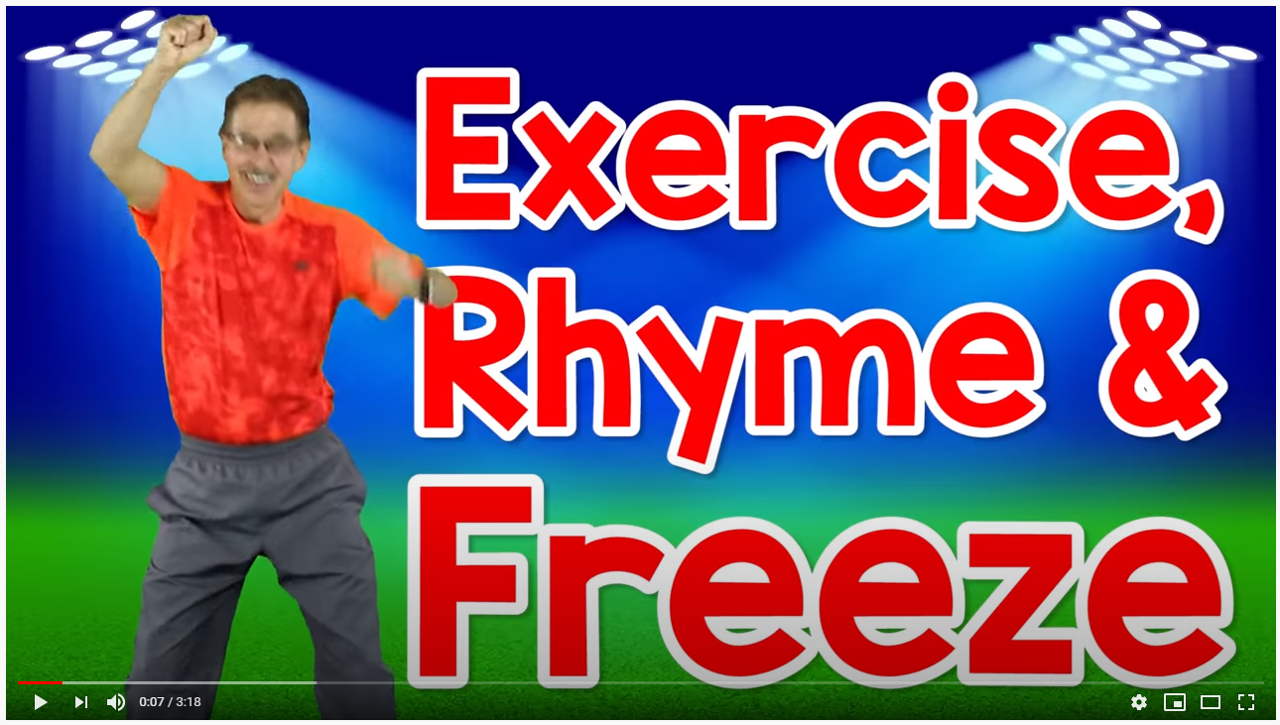
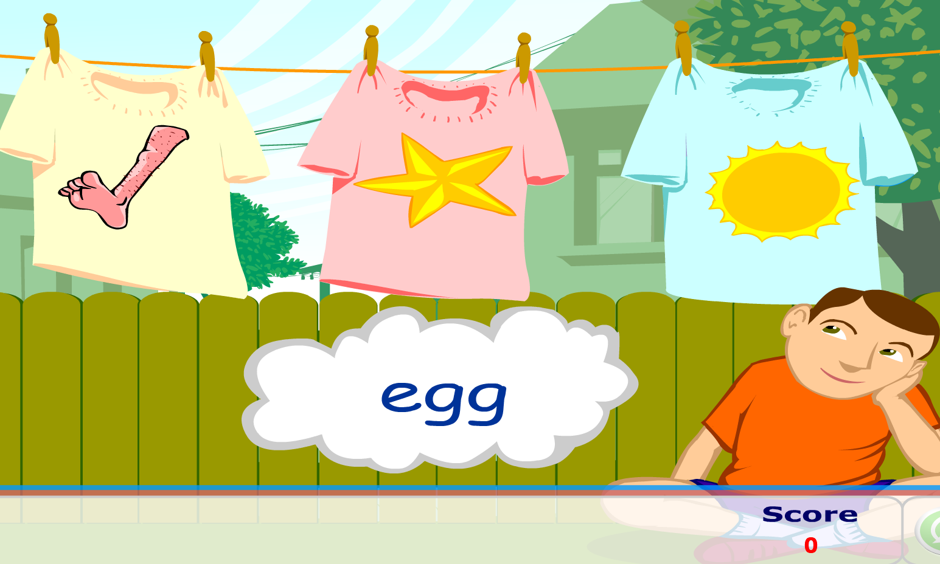
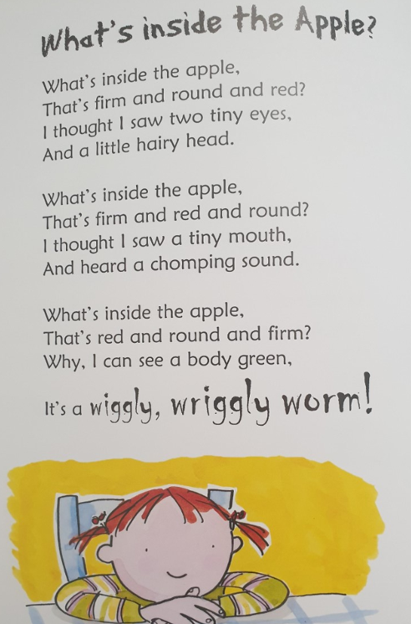
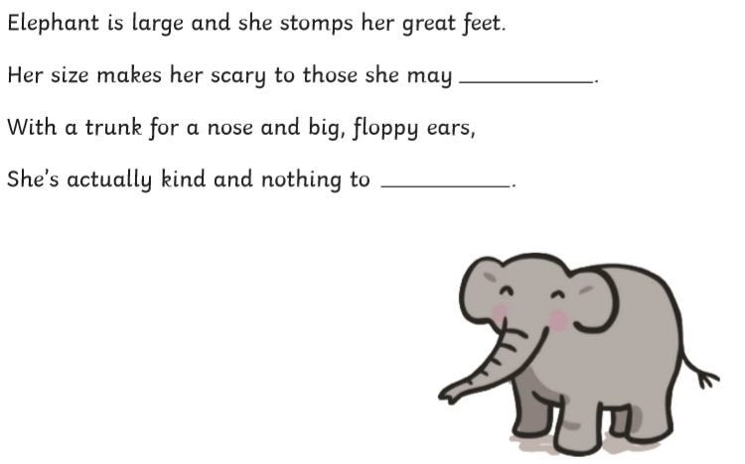
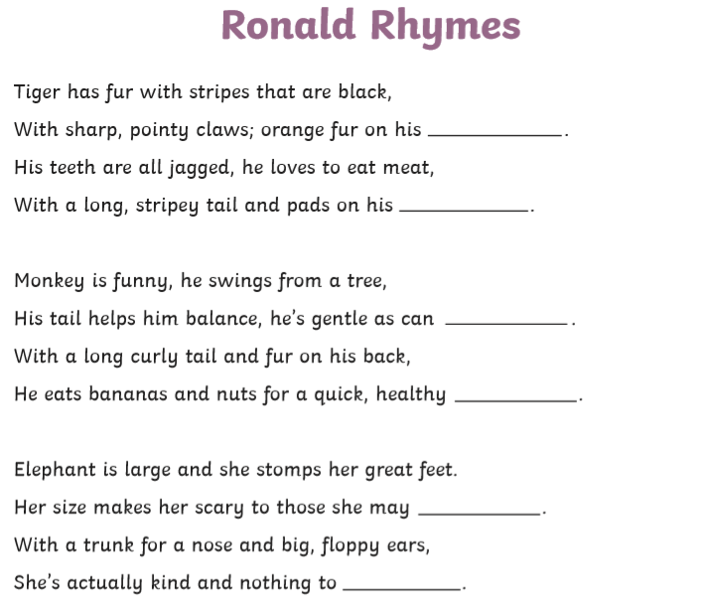
Date:2/6/20 Lesson Objective: To complete a rhyming poem.
Activity:
Think back to yesterdays rhyming activities. What did we learn about rhyming words? Watch and join in with Jack Hartmann (one of our year 1 favourites!) with the exercise, rhyme and freeze!
https://www.youtube.com/watch?v=cSPmGPIyykU
Play the washing line rhyming game to practice your rhyming again!
http://www.literactive.com/Download/live.asp?swf=story_files/washing_line_rhyme_US.swf
Today we are going to be thinking about some poems that rhyme. Remember that some poets use rhyme and some poets don’t. Read some rhyming poems together and think about where you always find the rhyming words- does it follow a pattern? (2. Rhyming poem examples document)
Task
You are going to be completing a rhyming poem today. Choose some different animal poems from English Task 2 and fill in the missing words. As an extra challenge, maybe you could ignore the word bank and think of your own rhyming words to use instead?

Slide 4
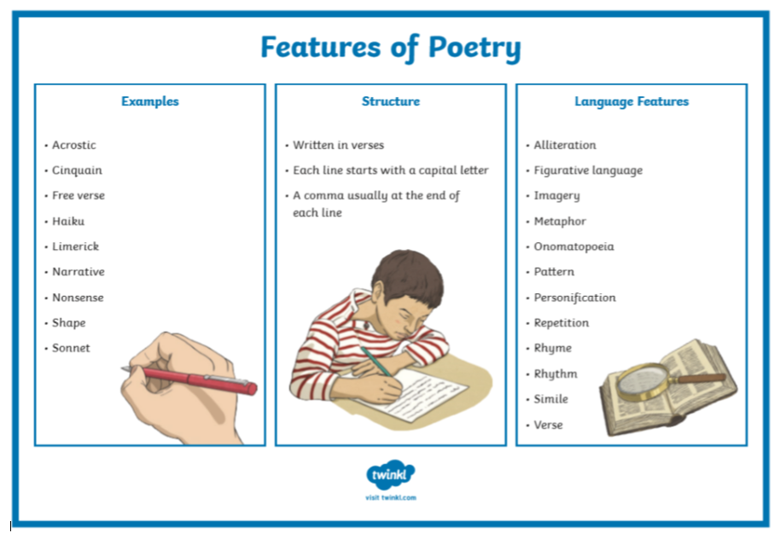
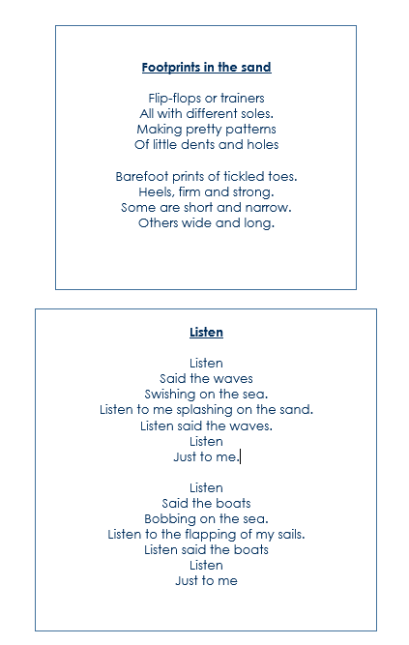
Date:2/6/20 Lesson Objective: To understand and identify the structure of a poem.
Activity:
We are going to be learning about the different features that we might find in a poem. Poems can be written in lots of different ways.
Poems can be written in different lengths, some are very long and some are very short! Some are even in shapes! They can use different types of language, such as the rhyme we have been learning about. Look at the 3.Features of a poem poster document to help you think about the different features that are used.
Today we are focusing on the structure of poems. We are going to be using the language ‘verse’ and ‘line’.
Lines- Are the different lines of writing that we can see in the poem, sometimes this can only be one word. These ‘lines’ make up the….
Verse (or we can also call it the ‘stanza’. We have written our own stanzas before!) This is when a collection of lines are put together in a poem to make a verse. To tell or add to the story of the poem. Some poets write poems in very clear verses- some poets do not.
Task
Read the poems ‘footprints in the sand’ and ‘listen’ on English Task 3 document. What are these poems about? What type of language does the poet use?
In one colour, identify and colour where the lines of the poem are. In another colour, identify and colour where the verses of the poem are.

Slide 5
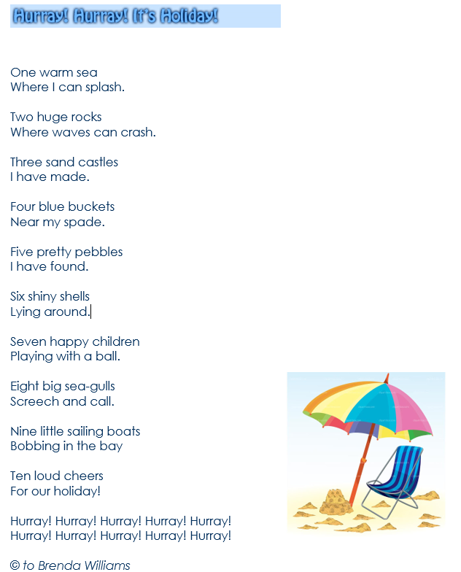
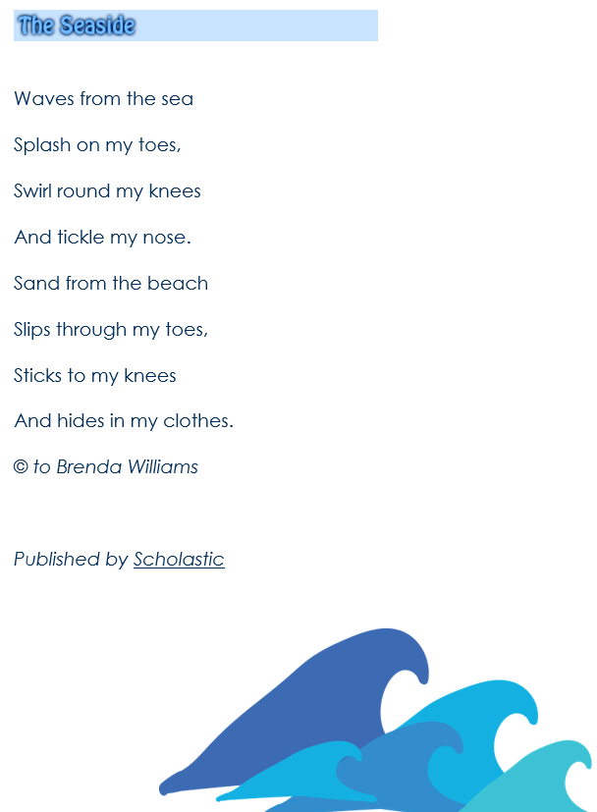
Date:4/6/20 Lesson Objective: To learn and recite a poem using actions and intonation.
Activity:
Today we are going to have some fun with poetry! Read through some of the ‘a collection of seaside poem’ examples with an adult. (Collection of seaside poems document)
Pick your favourite one! Maybe you picked a poem that rhymes or maybe you picked a poem that is about something you love about the seaside.
Read the poem aloud, carefully sounding out any words that you might be unsure of- you could use your sound buttons/ digraph, trigraph lines to help you decode.
Think about the rhythm and the ‘intonation’ (remember that’s how you use your voice to read aloud) the poem will need when you read it. Practice it a few times- can you add any actions to your poem to make your reading aloud even better?
Task
Practice and perform your poetry to others! Make sure to use your voice in an exciting and interesting way!

