Slide 2
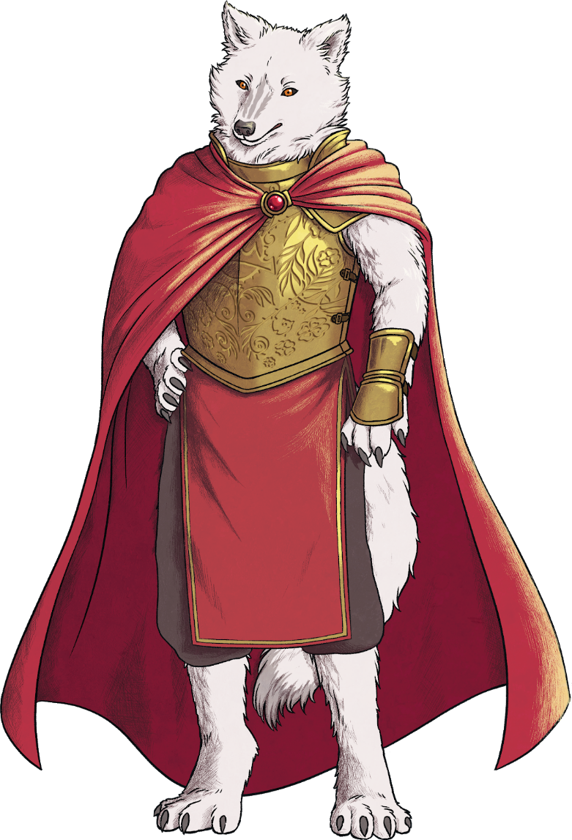
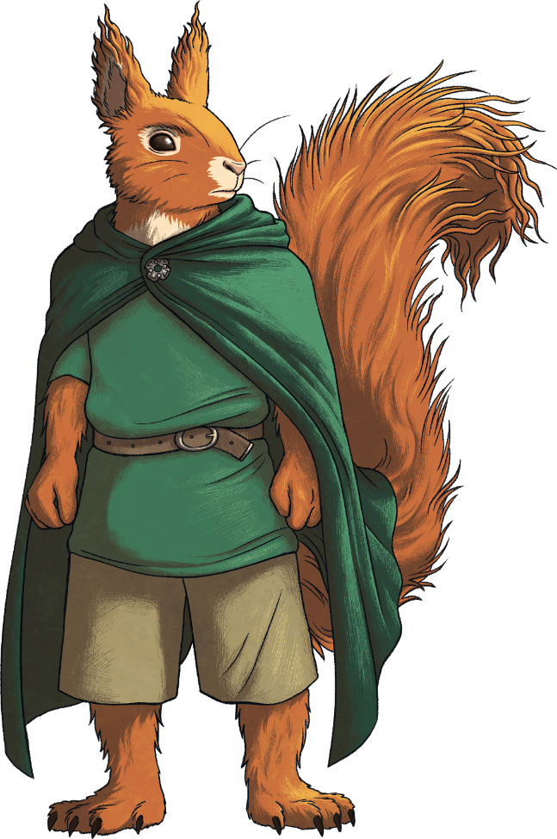
Planning an Adventure Story
It’s time to plan your own adventure story. Your plan will be in four parts:
Part One: The Fantastical Setting
Part Two: The Hero and Their Quest
Part Three: The Villain
Part Four: The ‘Hero’ Moment

Slide 3
Part One: The Fantastical Setting
How do you create a fantasy land?
Think of one special thing about your world and make it the focus.
e.g. The weather can be controlled.
Derrius is a world where
a magical king controls the
weather. He uses special
items to turn his enemies into
talking animals.

Slide 4
Part Two: The Hero and their Quest
Who is your hero and what do they want?
Your hero must have a problem to overcome.
e.g. He has always felt ignored but must now take charge.
Cole is a young boy who is
Cole wants to defeat the king
looking for his place in the
and return the magical seals to
world. He is chatty, loves telling
the people of Deriuss.
stories, and is brave.

Slide 5
Part Three: The Villain
Who is your villain and what do they want?
The villain should be the opposite of your hero. It doesn’t have to be a person but could be a force of nature or a difficult task.
e.g. Can control the weather but uses the power to fuel their own greed.
An old king who wants to rule
over all people and keep all the
benefits of magic to himself.
He is selfish, cruel and greedy.

Slide 6
Part Four: The ‘Hero’ Moment
How does your hero prove themselves?
This is the moment your main character succeeds and defeats the villain.
e.g. He distracts the villain while the people rise up against their king.
Cole and the people of Deriuss
defeat the king by rising up at a
party in the capital city. The animals
and people share the seals and
bring life back to their world.

Slide 7
How to Plot an Adventure Story
Now that you have decided the basics of your story, use a story mountain to help you to structure the events in your story.

