Slide 1
Maths – Week 3
Monday 8th June
Lesson Objective: Counting by 2’s

Slide 2
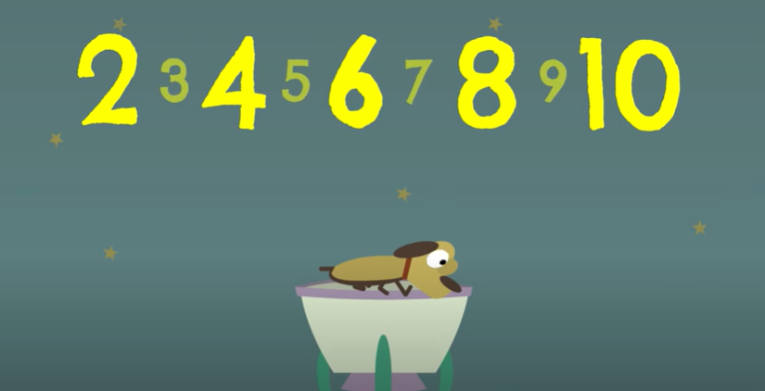
Lesson 1 - Parent notes
Counting in 2s is a useful skill to practise as this will help your child for the transition to year 1.
Here is a fun song to listen to a few times which hopefully will enable your child to recite counting in 2’s! https://www.youtube.com/watch?v=GvTcpfSnOMQ

Slide 3
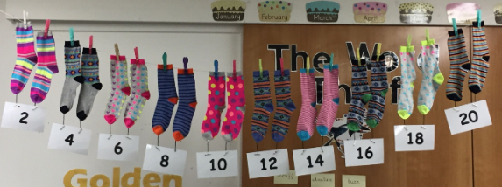
Parent notes
Counting in 2s is a useful skill to practise as this will help your child for the transition to year 1.
Here is a fun song to listen to a few times which hopefully will enable your child to recite counting in 2’s! https://www.youtube.com/watch?v=GvTcpfSnOMQ
As well as reciting from 2 to 10, and then 2 – 20, could you explore objects such as toys or colour blocks and arrange them in groups of 2, then count them (pairs of socks are good for this – how many socks? Can you count them in 2s?

Slide 4
Activities over the next week. These can be completed through your child’s play.
Counting socks/blocks/toys etc. in 2’s
Drawing numbers with chalks on the ground and hopping – counting in 2s.
Have fun and be practical!
Upload any work to tapestry.
See next slide for an overview of the week…

Slide 5
Weekly Overview:
Monday: Introduction to counting in 2s
Tuesday: Watch the song again, and complete Cut and Stick worksheet (If you cannot print, can your child write, cut, stick and make a counting in 2s number line?)
Wednesday: Watch and sing the song. Complete the missing numbers counting in 2s worksheet (If you cannot print, look at the sheet on screen with your child and can they tell you the numbers that are missing? Could they draw their own sheet based on what they see?)
Thursday: Counting in 2s – Noah’s Ark. Open the PowerPoint for instructions
Friday: Counting Shoes! Open PowerPoint for instructions.

