Slide 1
Subject: English Year Group: 1 Week Commencing: 29/6/20
For subject information, games and activities to support this planning, please also look on the ‘Help your child with English’ document saved on the class page.

Slide 2
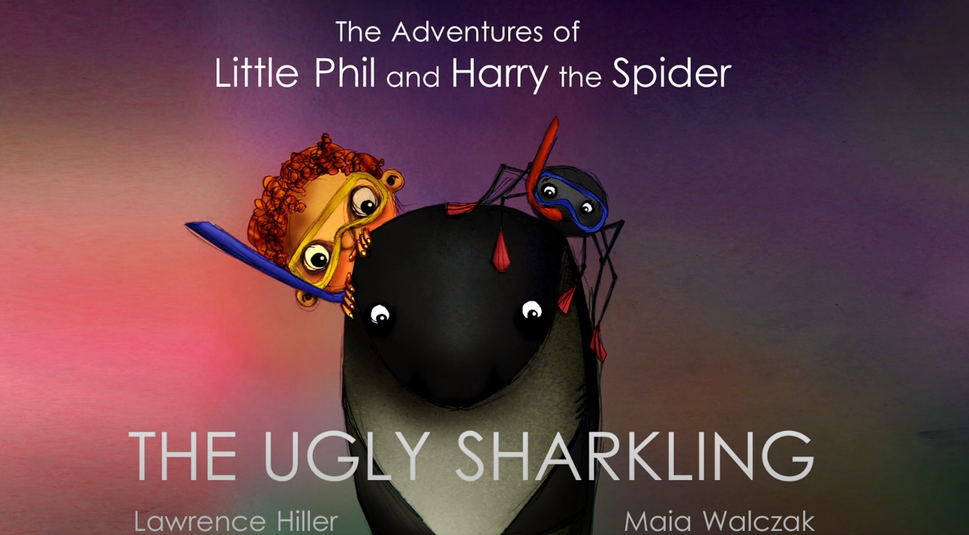
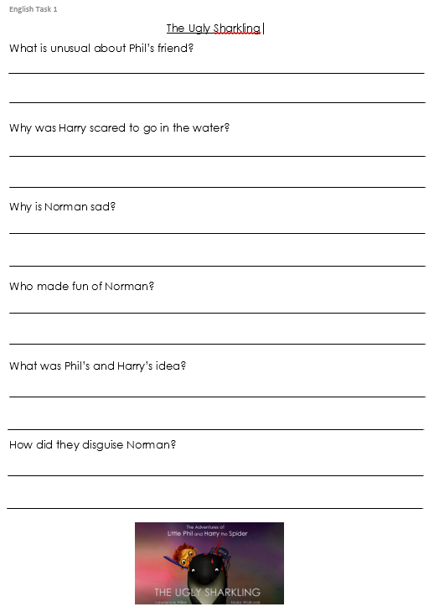
Date: 29/6/20 Lesson Objective: To answer comprehension questions based on the story of ‘The Ugly Sharkling’.
Activity:
We are very lucky to live in Cornwall as we are surrounded by beautiful beaches. Have a think…
What sorts of things do you find at the beach?
What animals might you see?
What might you get up to at the beach?
What is your favourite part about going to the seaside?
Watch the video telling the story of ’The tale of the ugly sharkling’. https://www.youtube.com/watch?v=o0PIb0V3YEY&t=2s
Task
Talk about the following questions and answer each one carefully. You can use the template on English Task1 or just record your answers on some lined paper. You may wish to watch the video again to help you:
What is unusual about Phil’s friend?
Why was Harry scared to go in the water?
Why is Norman sad?
Who made fun of Norman?
What was Phil’s and Harry’s idea?
How did they disguise Norman?

Slide 3
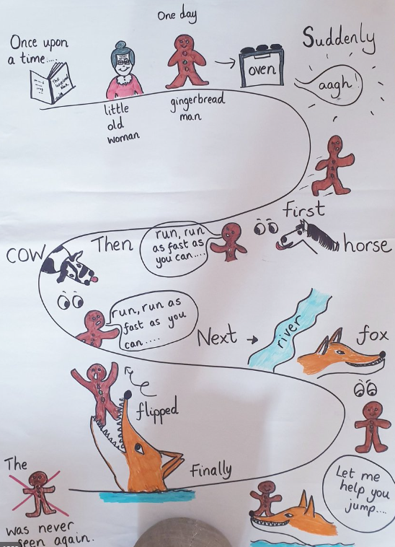
Date: 30/6/20 Lesson Objective: To re-tell the story of the ugly sharkling .
Activity:
Watch ‘The tale of the ugly sharkling’ again -https://www.youtube.com/watch?v=o0PIb0V3YEY&t=2s
Today we are going to be drawing a ‘story map’ to re-tell the story. A story map uses pictures and key words to re-tell the story. You will need to decide on the important parts of the story that have to be included (you will not need to include every single part!) Here is an example of a story map for The Gingerbread Man so that you can see what you need to do.
Task
Draw a story map with key symbols and words to help you retell the story.
Once you have drawn your story map, can you retell it to someone in your house? Add story language like One day, suddenly, after that, soon, next, in the end.
You may want to watch and pause the video throughout to help you with the story map.

Slide 4
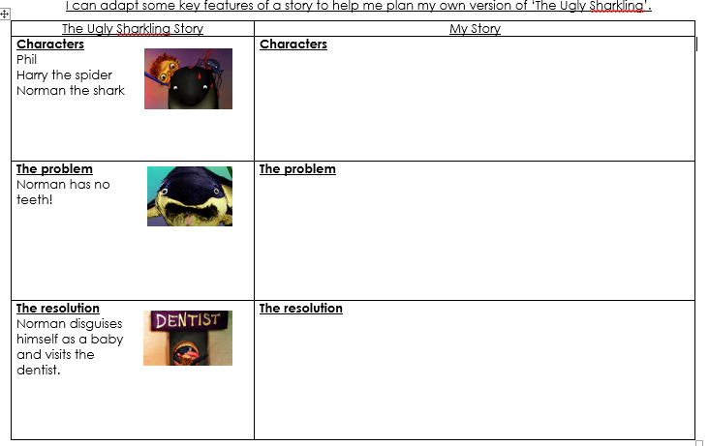
Date: 1/7/20 Lesson Objective: To plan your own version of the story of the ugly sharkling .
Activity:
Watch ‘The tale of the ugly sharkling’ again -https://www.youtube.com/watch?v=o0PIb0V3YEY&t=2s
Today, using your story maps to help you, you are going to plan your own version of ‘The Ugly Sharkling’ story.
Task:
Keeping the same setting, you are going to think of your own characters and problems they might have. You are going to be adapting three important features…..
-The characters : Norman might be an octopus, Harry might be a bumble bee…
The problem : The octopus might not be able to see and needs glasses…
The resolution : The octopus then visits the opticians…
You can draw out and write key sentences for your adaptation using English Task 3 sheet, or just record them on a piece of paper. We will be using these plans to write our own version of the story over the next 2 days.

Slide 5
Date: 2/7/20 & 3/7/20 Lesson Objective: To write your own version of the story of the ugly sharkling .
Activity:
Watch ‘The tale of the ugly sharkling’ again -https://www.youtube.com/watch?v=o0PIb0V3YEY&t=2s
Look back over your plans for your adapted story from yesterday. Can you re-tell the story orally using your characters?
Task:
Over the next two days you are going to write and then illustrate your own version of the story. Don’t forget that your story needs a title at the beginning!
Use this basic structure to help you when you are writing your version:
-Beginning, we meet the characters in their setting. What are they like as characters? Why are they there?
-Middle, we find out the problem and a plan is put together to solve it!
-End, a resolution to the problem!
You can use the templates provided on English Task 4/5 or just
write your story on paper or in a special notebook but please try to
write on lines- it really helps with handwriting!
Here are some things that you should try and include in your story:
-full stops, capital letters, finger spaces
-verbs ,nouns and adjectives
Story language
Reach for the sky!
Joined handwriting
Speech marks

