Slide 1
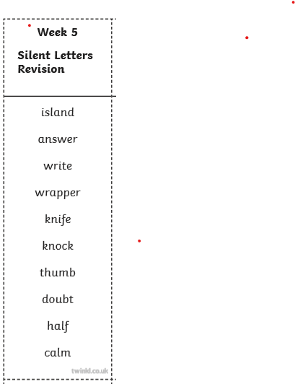
Date: 29/6/20 Lesson Objective: How to spell words with silent letters.
Activity: Spellings
Test: Spelling words for Wk 4. Words ending in suffix ‘ture’.
Learn: Spelling words for Wk 5 , words with silent letters.
. View the spelling rule PowerPoint on the website page.
Have fun with the wordsearch.
Choose interesting activities from the ‘challenge’ to help learn your spellings:
Make up a wordsearch; write the words in rainbow; write your spellings into a layer of sand or flour; use a ball or balloon to throw and say each letter in turn, write spellings in a pyramid.
You could also take the opportunity to practise your best handwriting by creating sentences that include your spellings.

Slide 2
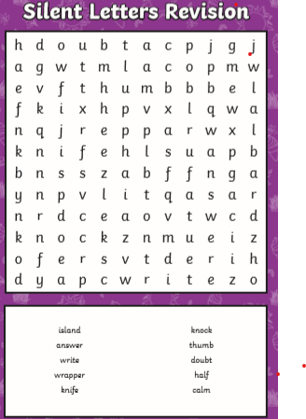
Spelling support.
Can you find this week’s spellings in the word search?
Write some sentences using these words.
Try making your own word search up using the spellings.
See if someone in your house can complete it.

Slide 3
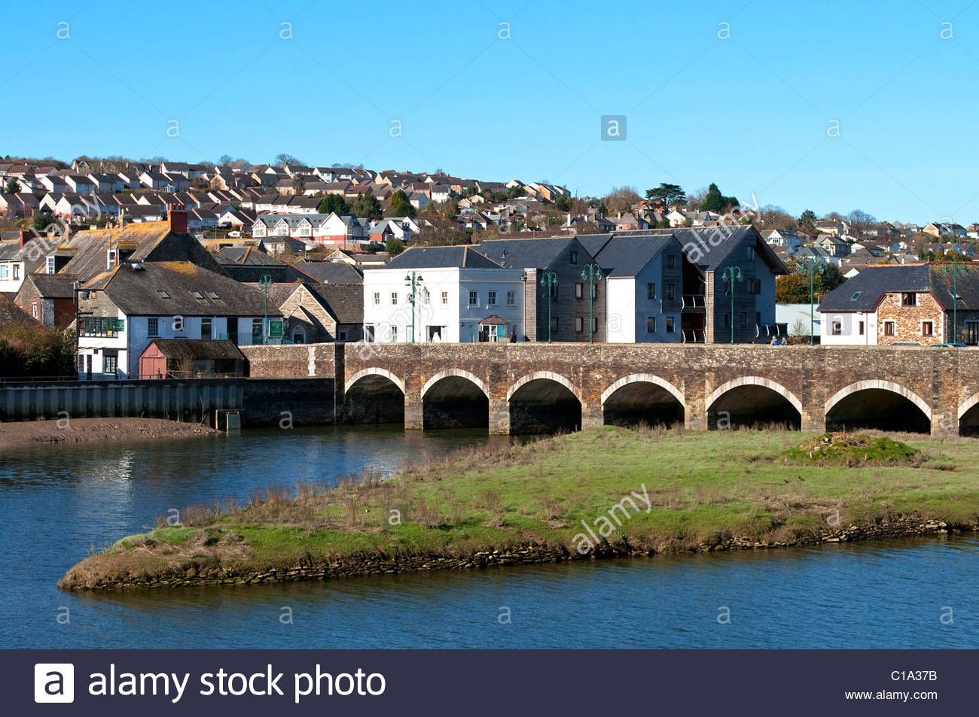
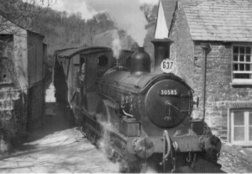
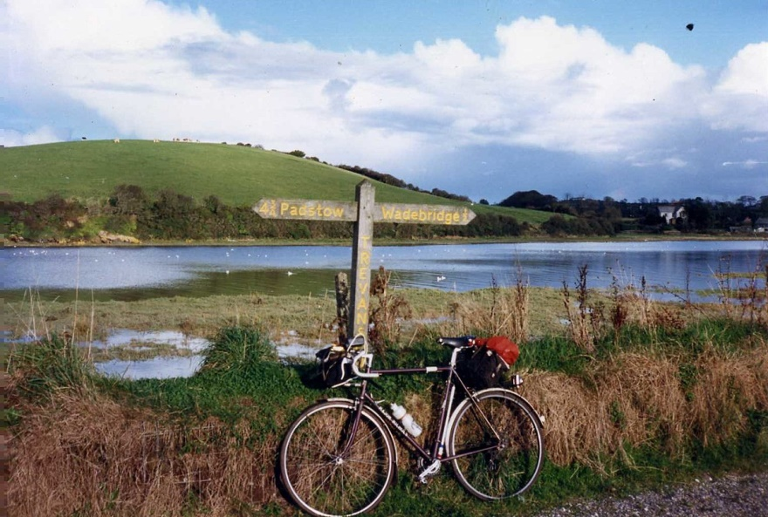
Over the next two weeks, we are going to learn about the history of our local area - Wadebridge.
We live in a very interesting place so there is lots to discover.
Last week, you wrote a lovely information text about plants and animals and this week you will gather information and then next week produce a beautifully written and illustrated information text. It could be in the form of an iPad presentation, leaflet or booklet about Wadebridge and its rich history.

Slide 4
Date: 30/6/20 Lesson Objective: To research historical information about Wadebridge
This slide is for children who are working from home.
Dear Children,
To start you off, if you are able to go out and about and find some local history, here is a little treasure hunt for you to do.
Can you find the answers to these questions …
(Tip Read all the clues first so you can plan your route!)
1.When was the old bridge built and who built it? (Clue:You will need to look at the end of the old bridge)
2.How many arches does it have now?
3.Where is the iron spike on the bridge? (Can you find out why it was there?)
4.When was Anneka’s Bridge built? (Clue:Go to Anneka’s bridge)
5.In which road is the old station building?

Slide 5
Date: 30/6/20 Lesson Objective: To research historical information about Wadebridge
This slide is for children who are working from home.
6. Who was the architect that designed the Town Hall?
7. What stone was laid by Lady Robartes on 1st February 1887?
8. What date was the Town Hall opened and by whom?
9. Pridham House and The Elms are the oldest houses in Wadebridge. Can you find where they are?
10.Where is the Wadebridge Reservoir and when was it completed?
11. What does the stone opposite Pod Stores commemorate?
12.How many names are on the War Memorial at Coronation Park?
13.What was the bollard that is now by Julian Foye’s used for?
14.How many windows does Gonvena House have at the front?

Slide 6
If you are unable to go out and about or are at school then use your iPads or books to research the history of Wadebridge.
Can you find out …
When was the old bridge built and who built it?
How many arches does it have now? How many did it have originally?
When was Anneka’s Bridge built?
In which road is the old station building?
When was the railway through Wadebridge built?
What was the slate from the slate quarry along the Camel Trail used for?
Why was Guineaport Road given its name?
Why was Eddystone Road given its name?
What was Wadebridge called originally?
What did people do before and after they crossed the river?
When was Gonvena House built and who built it?

Slide 7
Date: 1/7/20
Lesson Objective: To research historical information about Wadebridge
Now you found out the answers to your questions, can you find out more information about the history of Wadebridge?
You could focus on one aspect of Wadebridge’s history, such as the railway, the bridges or the river, or research several different areas.
As you research, make notes about what you discover. Remember: When you take notes, you are only using key vocabulary – NOT writing out the whole sentence. You might like to use a mind map or bullet point list to gather your notes.
There’s lots of information on the Internet. If your adults at home are members of Facebook then ask them to visit ‘Wadebridge Memories’ you will find lots of useful information on their pages.

Slide 8
Date: 2/7/20
Lesson Objective: To research historical information about Wadebridge
Read through the research that you did yesterday. Can you find out any more information by visiting other websites?
All good historians interview people who know about the area so you might find that your grandparents or other family know lots of interesting things about Wadebridge. You might like to interview them and video your interview.
Ask if you can phone your family or friends to interview them if they don’t live in your house.
What do they remember and how has Wadebridge changed?

Slide 9
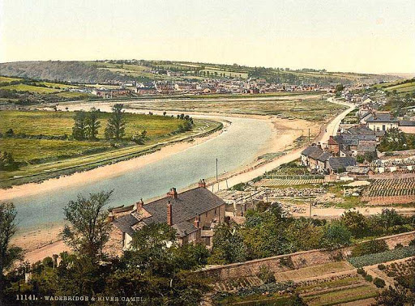
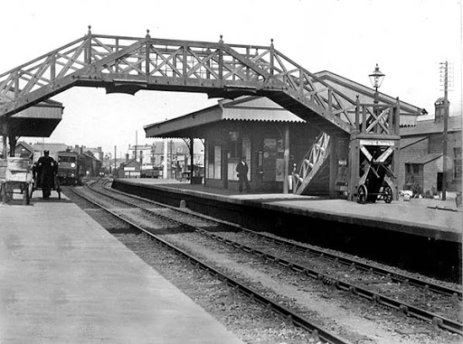
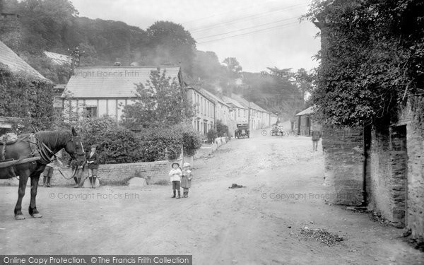
Date: 3/7/20
Lesson Objective: To research historical information about Wadebridge
All great information texts have lovely photos and drawings. Can you find some images or draw some pictures to illustrate your information?
If you have time at the weekend you might like to try the Treasure Hunt and find answers to the questions.

