Slide 1
Maths – Tuesday 19th May
Time – Make a floor clock!

Slide 2
Parent notes
Yesterday we explored a clock face. Recap with your child what the big hand is (minute hand), and small hand is (hour hand)
Remind them that when the minute hand points to the 12, it is ‘O’clock’, we look at the hour hand to say what time it is… e.g. 2 o’clock.
Today your child has a challenge to make a clock face on the floor. See the next slide for ideas. This can be done inside, outside, with chalks, number cards, sticks etc.

Slide 3
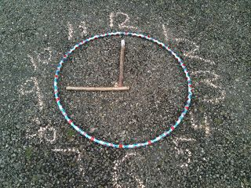
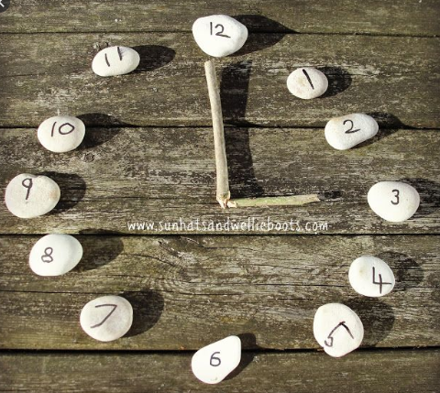
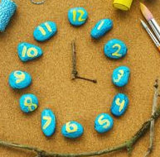
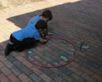
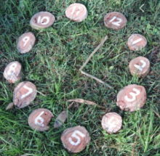
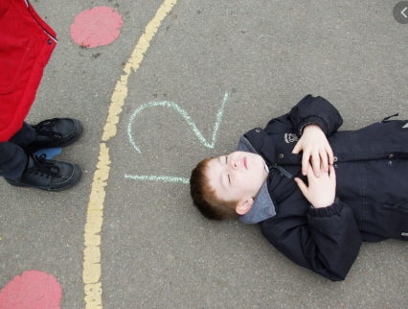
Make a clock face on the floor! What numbers do you need? How many hands? Make sure the hands can move!
Now get your teacher to call out different times for you to make on your floor clock!

