Slide 1
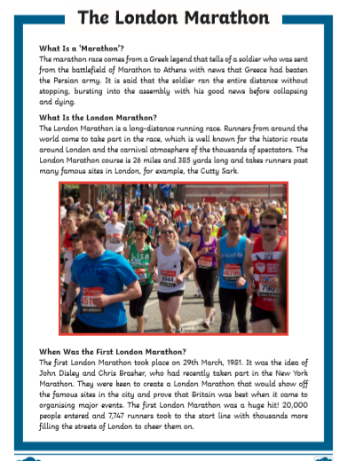
Date: Monday 6th July 2020 Lesson Objective: To spell accurately.
Activity: Spellings
Test the children on the spellings – this weeks focus is using adverbials of manner.
View the spelling Powerpoint. Read through it together. Are there anymore words that you can think of?
Choose activities to help learn your spellings:
Make up a word search.
Write the words in rainbow.
Use sand or flour to create words.
Use a ball or balloon to throw and say each letter in turn.
Pyramid spellings.
Complete the reading comprehension.

Slide 2
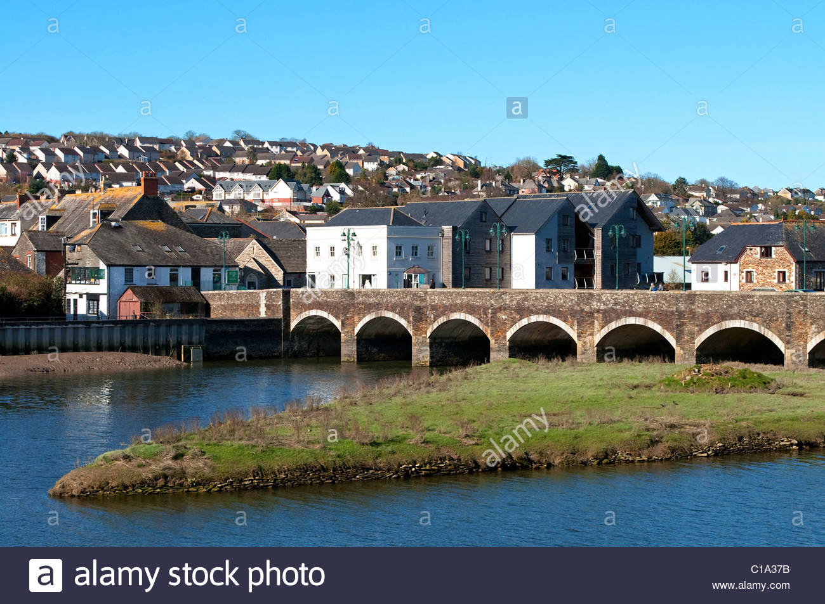
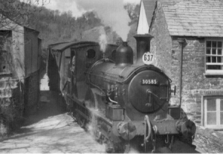
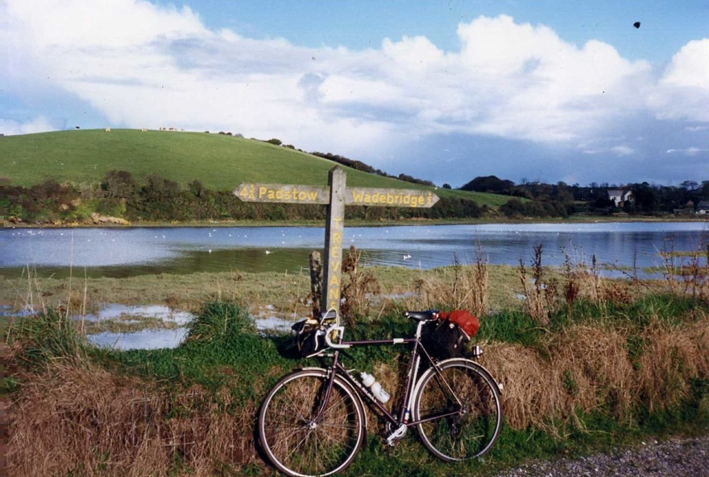
How did you get on with the Wadebridge Treasure Hunt? Did you discover some of the town’s interesting history? Was there a discovery that really interested you and made you want to learn more?
This week, you could complete some further research to discover even more interesting facts about our town. Do you remember how you make short notes about key information when you wrote your information leaflet abut France? Check your notes to ensure you have enough information. You may wish to do a little more research.
This week you will:
Do further research, if needed.
Answer questions about the town’s history.
Use the Internet, books and local people to make notes.
Write up your notes into interesting sentences.
Design and write an information text – It could be a poster, leaflet or a booklet. You could use paper or an app on your iPad or computer.

Slide 3
Date: Tuesday 7th July 2020 Lesson Objective: To check and improve notes.
Read through the answers to the questions you found last week and the notes that you made. Edit them and find further information if you need to.
Practise writing sentences from your notes.
For example:
Notes
old bridge stone arches River Camel
Sentence
The old bridge over the River Camel was built of stone and has many arches.
Include technical vocabulary in your sentences. Check the toolkit (See ‘toolkit’ resource) for more signs of success which can be included in your sentences.

Slide 4
Date: Wednesday 8th July 2020 Lesson Objective: To design an information text.
Now you are ready to start to design your information text. Take a look at the Tool Kit (separate resource) and the example on the next two slides.
Activity - Plan out how you would like your work to look.
Things to think about when planning…
Where will you place your pictures?
Where will your headings go?
Have you included the ALL of the features which are on the toolkit?
Have you included a fact box or a ‘Did you know?’

Slide 5
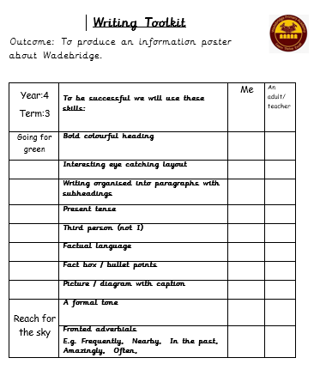
Information Text Toolkit
Can you include these text features in your work?
Heading – in bold writing
Sub-headings – in bold writing
Short paragraphs of text
Factual language
Pictures
Photos
Maps
Captions
Labels
Fact or ‘Did you know?’ boxes
…and of course, you will use your best handwriting and check your spellings.
(The toolkit is available as a resource if you wanted to tick off each feature that you have included)

Slide 6
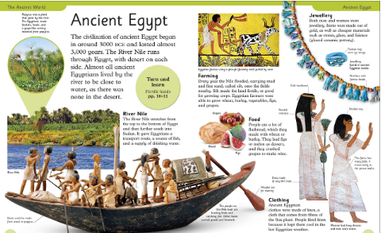
Look at this example of an information text to see how you could set out your own page.
Sub-headings
Heading (Bold writing)
Fact box
Pictures
Photograph
Label
Caption

Slide 7
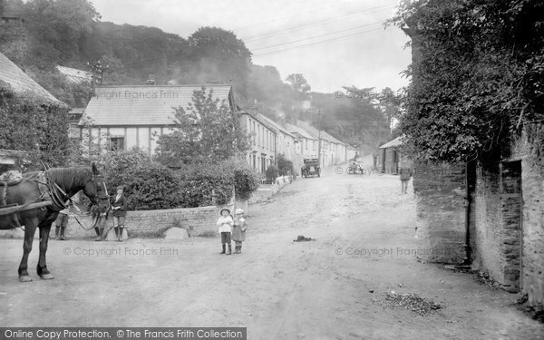
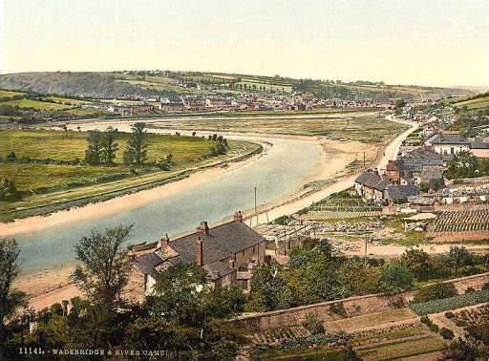
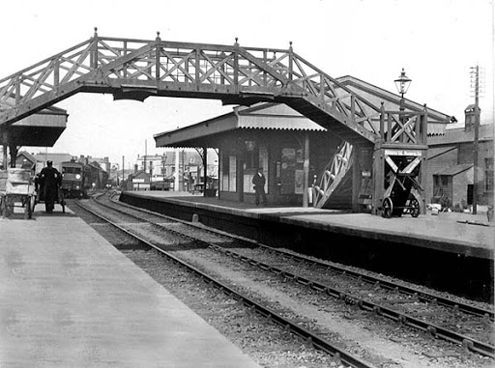
Date: Thursday 9th and Friday 10th July 2020 Lesson Objective: To produce an information text
Activity - Now you have prepared your ideas, you are ready to write!
Use your notes and sentences.
Check the Toolkit.
Have fun!
Remember, your teachers love to see your work, so please send us your finished product.
You may also like to send a copy of your work to anyone who has helped you with your research.

