Slide 2
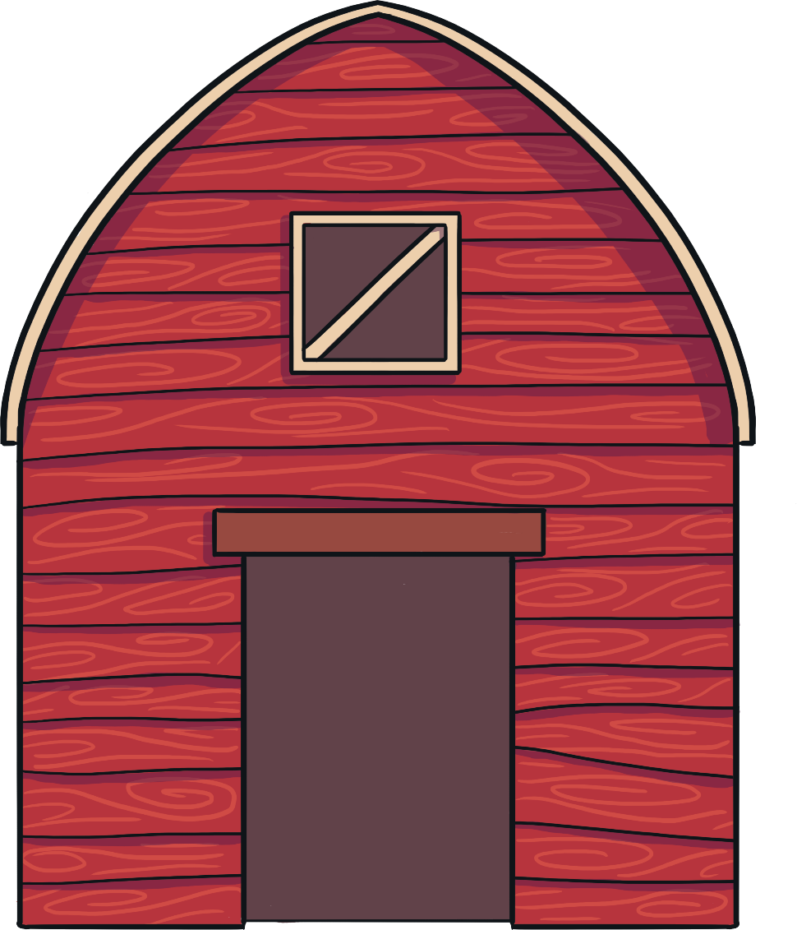
Instructions
Each picture shows a different number of farm animals in the farmyard.
Carefully, count how many animals there are. Then, click on the correct numeral.

Slide 3
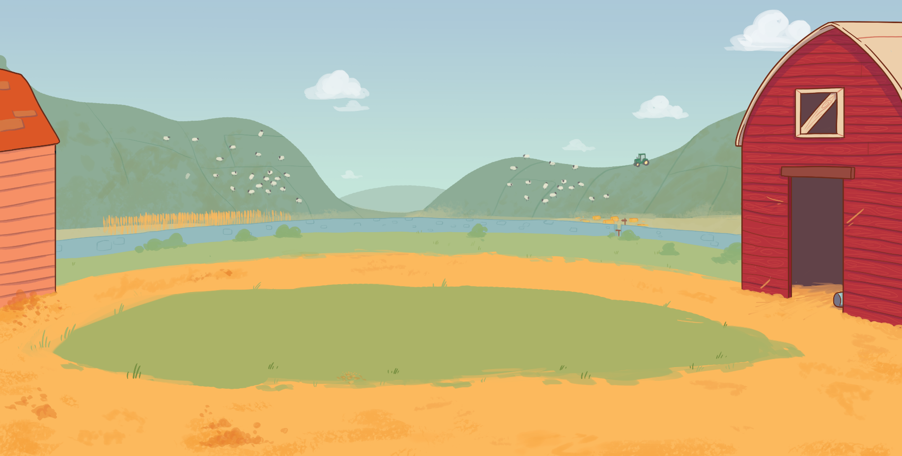
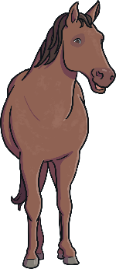
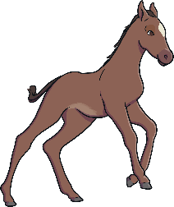
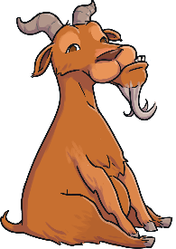
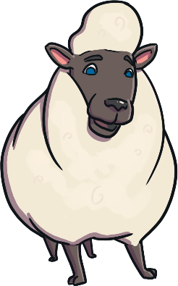
How Many Farm Animals?
2
5
3

Slide 4
Correct!
Next

Slide 5
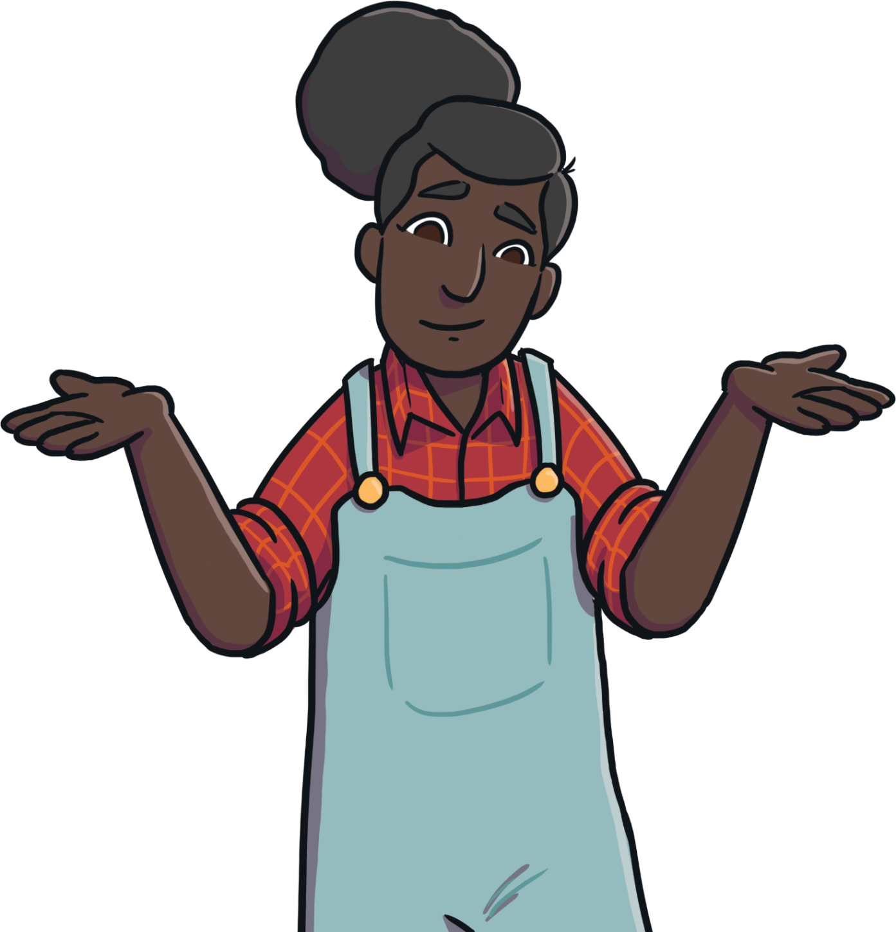
Try again!
Back

Slide 6
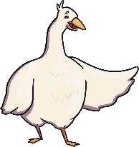
How Many Farm Animals?
0
4
2

Slide 7
Correct!
Next

Slide 8
Try again!
Back

Slide 9
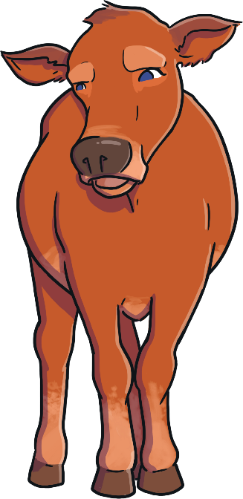
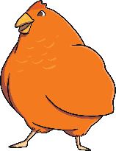
How Many Farm Animals?
9
6
8

Slide 10
Correct!
Next

Slide 11
Try again!
Back

Slide 12
How Many Farm Animals?
3
5
1

Slide 13
Correct!
Next

Slide 14
Try again!
Back

Slide 15
How Many Farm Animals?
10
6
8

Slide 16
Correct!
Next

Slide 17
Try again!
Back

Slide 18
How Many Farm Animals?
7
3
10

Slide 19
Correct!
Next

Slide 20
Try again!
Back

Slide 21
How Many Farm Animals?
4
5
2

Slide 22
Correct!
Next

Slide 23
Try again!
Back

Slide 24
How Many Farm Animals?
0
1
3

Slide 25
Correct!
Next

Slide 26
Try again!
Back

Slide 27
How Many Farm Animals?
9
8
4

Slide 28
Correct!
Next

Slide 29
Try again!
Back

Slide 30
How Many Farm Animals?
10
7
5

Slide 31
Well done!
Play again!

Slide 32
Try again!
Back

