Slide 1
Subject: Phonics Year Group: Reception Week Commencing: Monday 30th November
For subject information, games and activities to support this planning, please also look on our class blog for anything phonics, reading and writing related

Slide 2
Date: Monday 30th November Lesson Objective: To practise reading CVC words.
Activity:
First, please practise reading your Phase 2 tricky words from your mats we have to you a few weeks ago (the, I, no, go to and into.)
Please open up the PowerPoint up called ‘Phase 2 sounds powerpoint’ and practise recognising the letters and saying the matching sounds.
- Open up the Powerpoint called ‘CVC words reading’ and practise reading the words with your child.

Slide 3
Subject: Phonics Year Group: Reception Week Commencing: Monday 30th November
For subject information, games and activities to support this planning, please also look on our class blog for anything phonics, reading and writing related

Slide 4
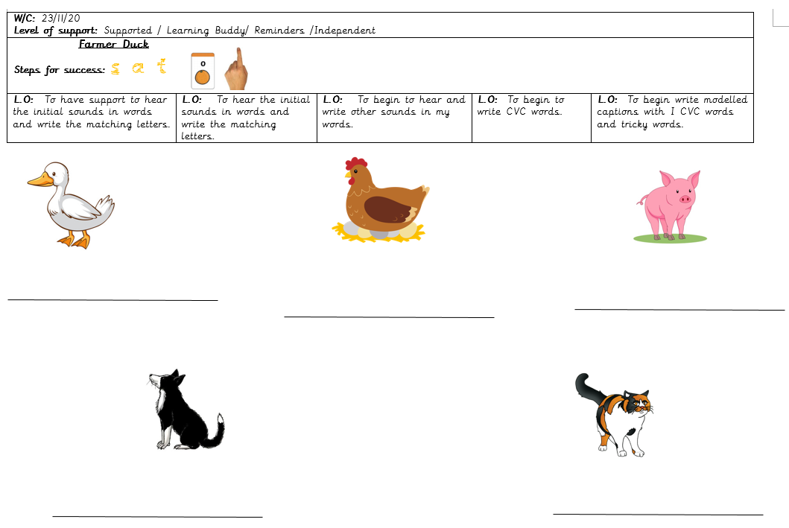
Date: Tuesday 1st December Lesson Objective: To practise writing CVC words/captions.
Activity:
Please open up the PowerPoint up called ‘Phase 2 sounds powerpoint’ and practise recognising the letters and saying the matching sounds.
Find the writing sheet in your folders with the pictures of the animals with lines underneath. Can write the words to match the animal?
Watch Miss Miskowicz’s writing CVC words video on Tapestry to help you to know how to support your child with writing words.
If you have not collected your folder from the office, please practise writing the following words on any mark making materials – pig, duck, hen, dog and cat.

