Slide 2
Encourage your child to practise their phonics reading with this CVC PowerPoint game.
Phonics is a method used to teach children to learn to read and write by sounding out words by their individual letter sounds, such as c-a-t.
Can your child make their own CVC words matching game with the letters they know from Phase 2 Phonics?

Slide 3
Can you help Felix read the word and click on the correct picture?
You’ll need to click the arrow in the corner to move to the next slide.
x
CVC stands for consonant-vowel-consonant. So, CVC words are ones like ‘dog’, ‘pen’ and ‘bus’ with a consonant letter, vowel letter and another consonant - like a sandwich! They’re very common in phase 2 phonics.
Next slide
Click me!

Slide 4
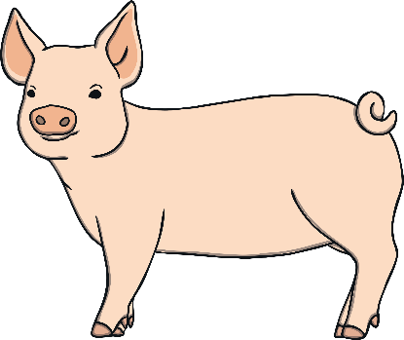
Click the correct picture
pan
Next slide

Slide 5
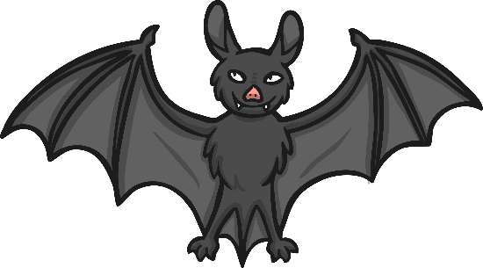
Click the correct picture
bat
Next slide

Slide 6
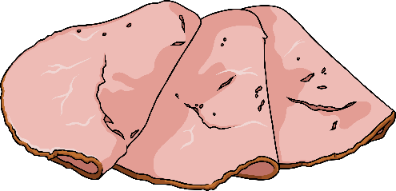
Click the correct picture
sit
Next slide

Slide 7
Click the correct picture
bed
Next slide

Slide 8
Click the correct picture
pig
Next slide

Slide 9
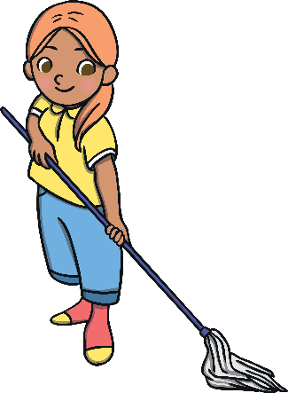
Click the correct picture
fan
Next slide

Slide 10
Click the correct picture
tap
Next slide

Slide 11
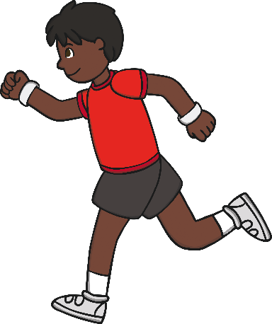
Click the correct picture
run
Next slide

Slide 12
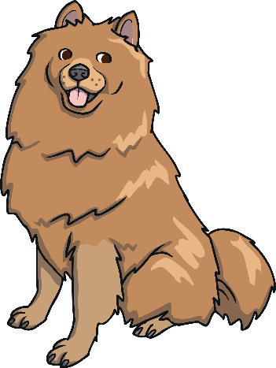
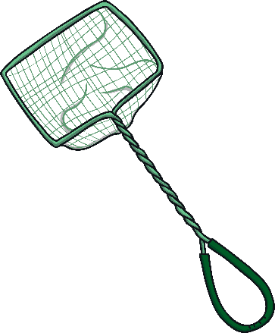
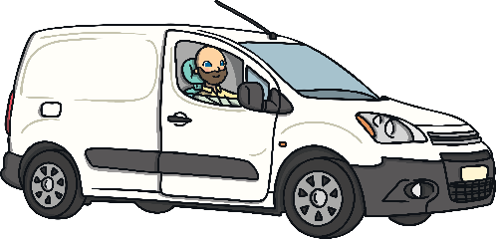
Click the correct picture
dog
Next slide

Slide 13
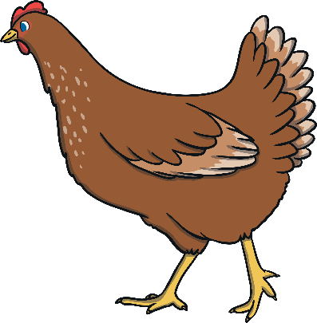
Click the correct picture
cap
Next slide

Slide 14
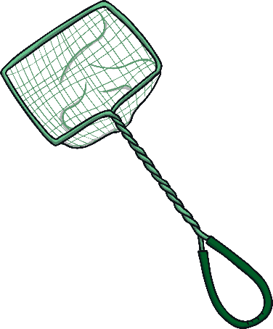
Click the correct picture
net
Next slide

Slide 15
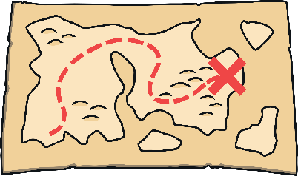
Click the correct picture
lap
Next slide

Slide 16
Click the correct picture
cat
Next slide

Slide 17
Click the correct picture
pen
Next slide

Slide 18
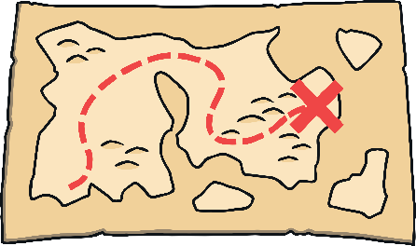
Click the correct picture
peg
Next slide

Slide 19
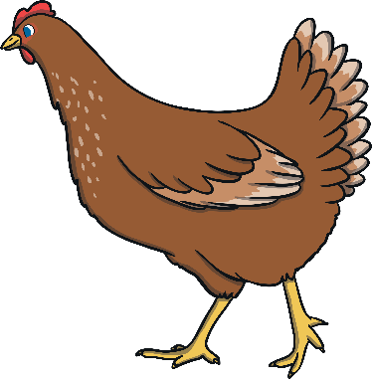
Click the correct picture
sun
Next slide

Slide 20
Click the correct picture
pin
Next slide

Slide 21
Click the correct picture
rug
Next slide

Slide 22
Click the correct picture
leg
Next slide

Slide 23
Click the correct picture
bus
Next slide

Slide 24
Click the correct picture
hen
Next slide

Slide 25
Click the correct picture
map
Next slide

Slide 26
Click the correct picture
mop
Next slide

Slide 27
Click the correct picture
mug
Next slide

Slide 28
Click the correct picture
hip
Next slide

Slide 29
Click the correct picture
hat
Next slide

Slide 30
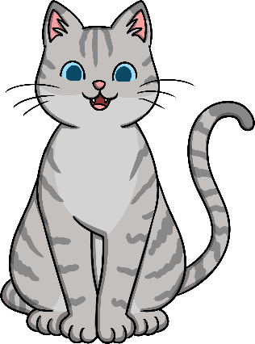
Click the correct picture
dig
Next slide

Slide 31
Click the correct picture
red
Next slide

Slide 32
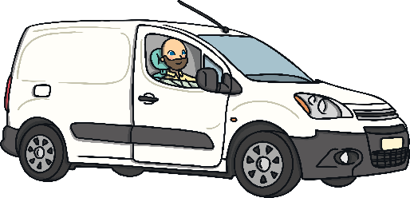
Click the correct picture
van
Next slide

Slide 33
Click the correct picture
wig
Next slide

Slide 34
Click the correct picture
men
Next slide

Slide 35
Click the correct picture
bag
Next slide

Slide 36
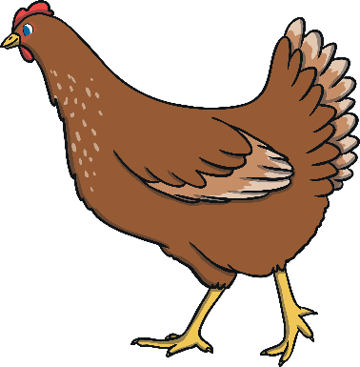
Click the correct picture
ham
Next slide

Slide 37
Click the correct picture
hot
Next slide

Slide 38
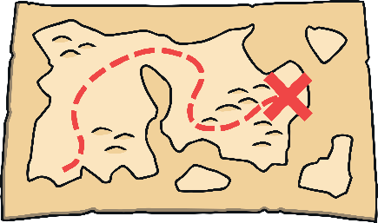
Click the correct picture
lip
Next slide

Slide 39
Click the correct picture
man
Next slide

Slide 40
Click the correct picture
pot
Next slide

Slide 41
I Can Read! Phase 2 Words Worksheet Pack
I Spy and Read: Phase 2 Phonics Activity

