Slide 1
Subject: Maths Year Group: Reception Week Commencing: Monday 4th January
For subject information, games and activities to support this planning, please also look on our class blog for anything phonics, reading and writing related

Slide 2
Session 1 Lesson Objective: To understand the meaning of zero.

Slide 3
Maths – session 1
Week 1
L.O: To understand the meaning of zero.

Slide 4
Warm up
https://www.youtube.com/watch?v=Qo_y5fQjlhI

Slide 5
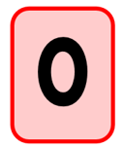
Teach L.O: To understand the meaning of zero.
What does zero mean?

Slide 6
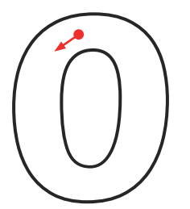
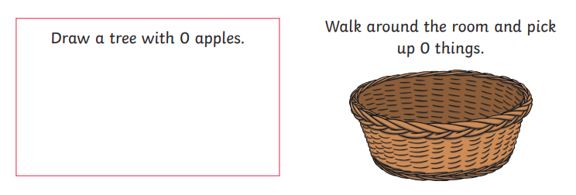
Practise L.O: To understand the meaning of zero.
Can you find zero on the numberline?
Can you practise writing the number zero?

Slide 7
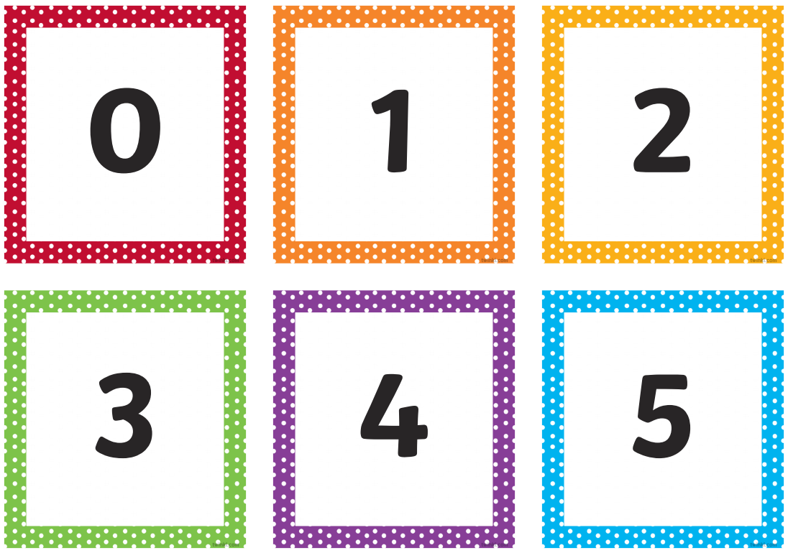
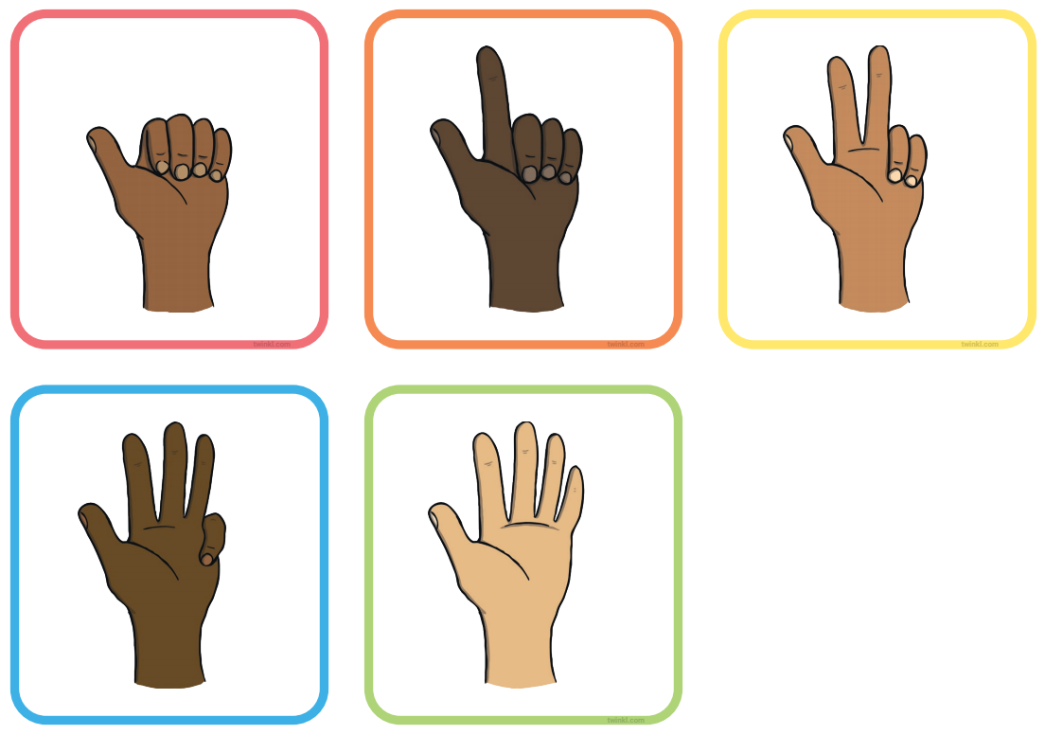
Apply L.O: To understand the meaning of zero.
Quick fire – show me this ___ many fingers! How can we represent 0?

Slide 8
Subject: Maths Year Group: Reception Week Commencing: Monday 4th January
For subject information, games and activities to support this planning, please also look on our class blog for anything phonics, reading and writing related

Slide 9
Session 2 Lesson Objective: To understand the meaning of zero.

Slide 10
Maths – session 2
Week 1
L.O: To understand the meaning of zero.

Slide 11
Warm up
https://www.youtube.com/watch?v=5DdQ-JgeWIA

Slide 12
Teach L.O: To understand the meaning of zero.
What does zero mean?

Slide 13
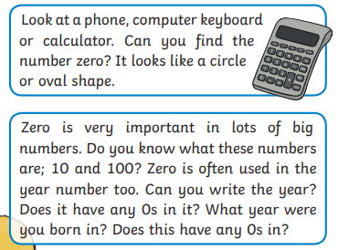
Practise L.O: To understand the meaning of zero.

Slide 14
Apply L.O: To understand the meaning of zero.
What numbers are represented in the pictures below?

Slide 15
Subject: Maths Year Group: Reception Week Commencing: Monday 4th January
For subject information, games and activities to support this planning, please also look on our class blog for anything phonics, reading and writing related

Slide 16
Session 3 Lesson Objective: To understand the meaning of zero.

Slide 17
Maths – session 3
Week 1
L.O: To understand the meaning of zero.

Slide 18
Warm up
https://www.youtube.com/watch?v=3wS3SxmGFKQ

Slide 19
Teach L.O: To understand the meaning of zero.
Who can show me a way of representing zero?

Slide 20
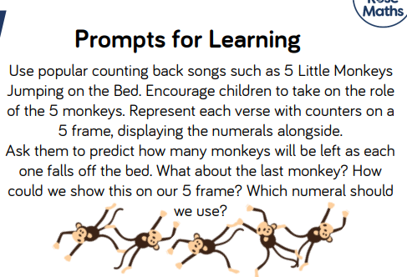
Practise L.O: To understand the meaning of zero.

Slide 21
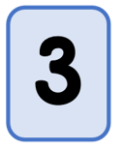
Apply L.O: To understand the meaning of zero.
What numbers are being represented here? How can you convince me?

