Slide 1
Subject: Phonics Year Group: Reception Week Commencing:4/1/21
For subject information, games and activities to support this planning, please also look on the ‘Help your child with English’ document saved on the class page.

Slide 2
Date: 6/1/21

Slide 3
What words do we already know that have this sound at the beginning? Can you think of any of your own words?

Slide 4
Let’s practise using the phoneme j…….
Can you blend the words……

Slide 6
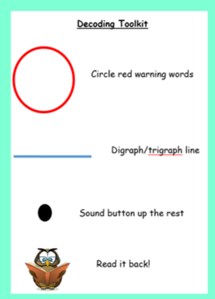
Sentence reading time!
Ask an adult to write these sentences down and then use the decoding toolkit to read them.

Slide 7
Subject: Phonics Year Group: Reception Week Commencing:4/1/21
For subject information, games and activities to support this planning, please also look on the ‘Help your child with English’ document saved on the class page.

Slide 8
Date: 7/1/21

Slide 9
What words do we already know that have this sound at the beginning? Can you think of any of your own words?

Slide 10
Let’s practise using the phoneme v…….
Can you blend the words……

Slide 11
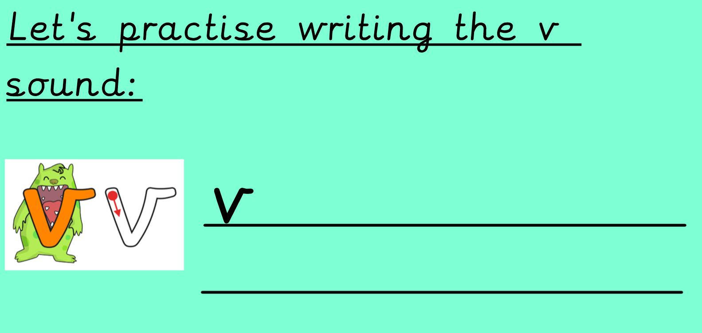

Slide 12
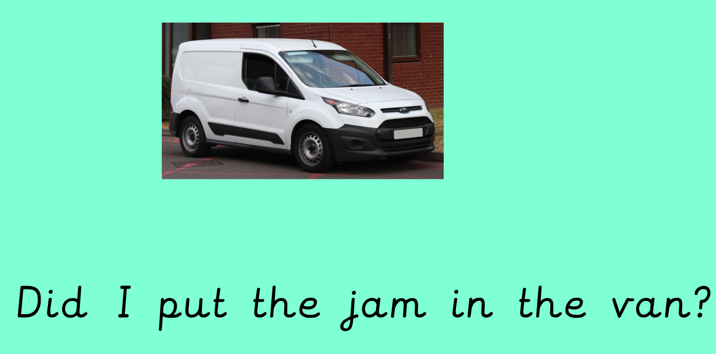
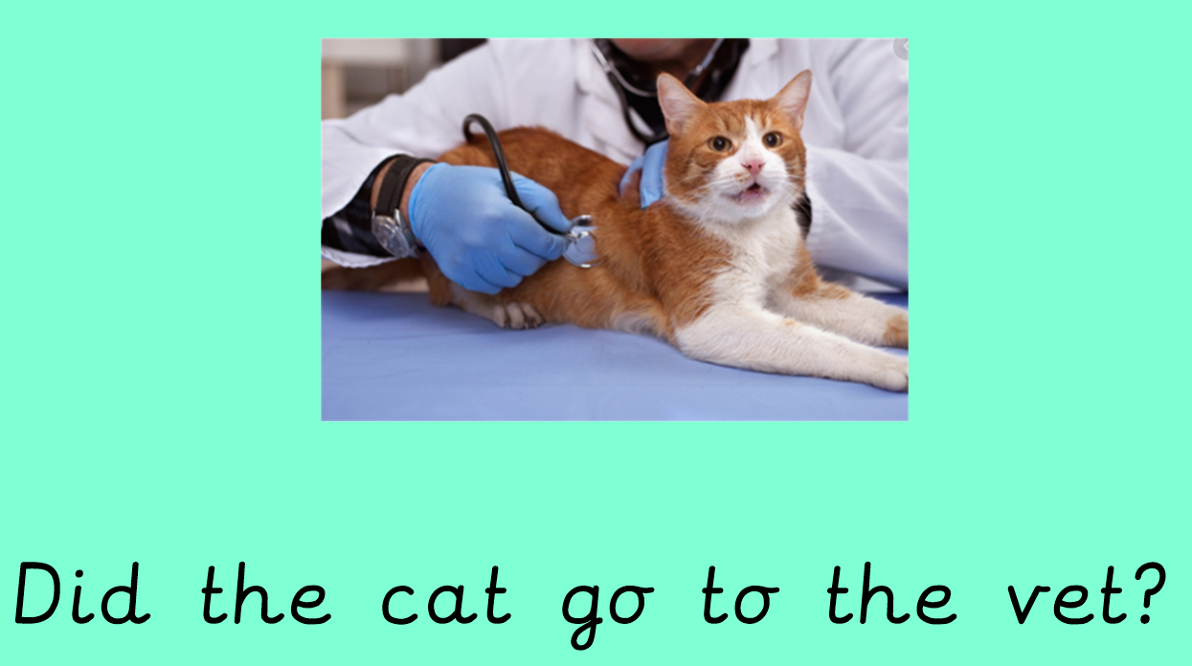
Sentence reading time!
Ask an adult to write these sentences down and then use the decoding toolkit to read them.

Slide 13
Subject: Phonics Year Group: Reception Week Commencing:4/1/21
For subject information, games and activities to support this planning, please also look on the ‘Help your child with English’ document saved on the class page.

Slide 14
Date: 8/1/21

Slide 15
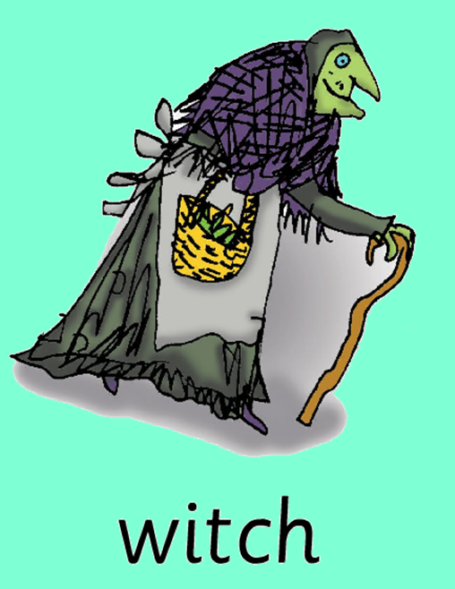
What words do we already know that have this sound at the beginning? Can you think of any of your own words?

Slide 16
Let’s practise using the phoneme w…….
Can you blend the words……

Slide 17
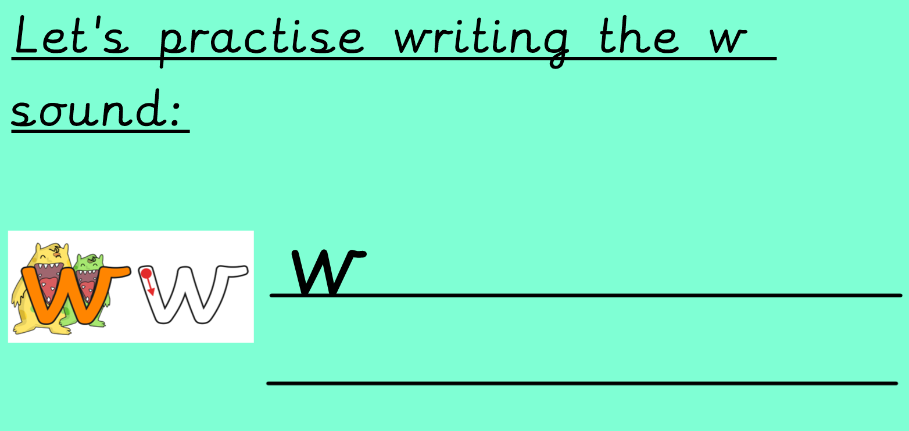

Slide 18
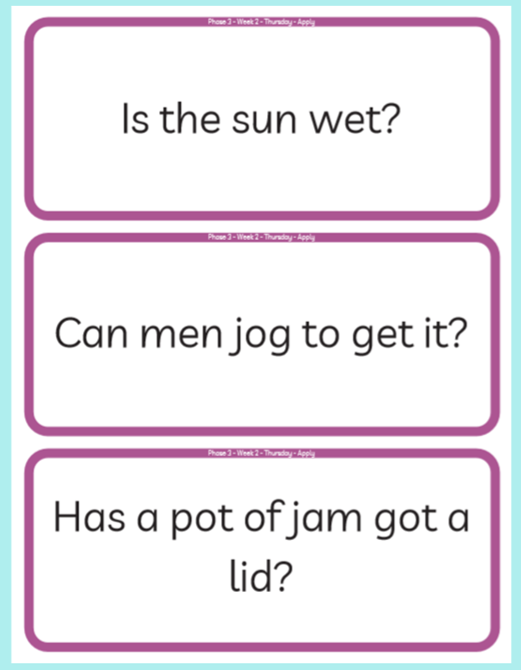
Question reading time!
Ask an adult to write these questions down and then use the decoding toolkit to read them.
Can you answer the questions?
Is the answer yes or no?

