Slide 1
Subject: Maths Year Group: Reception Week Commencing: Monday 11th January
For subject information, games and activities to support this planning, please also look on our class blog for anything phonics, reading and writing related

Slide 2
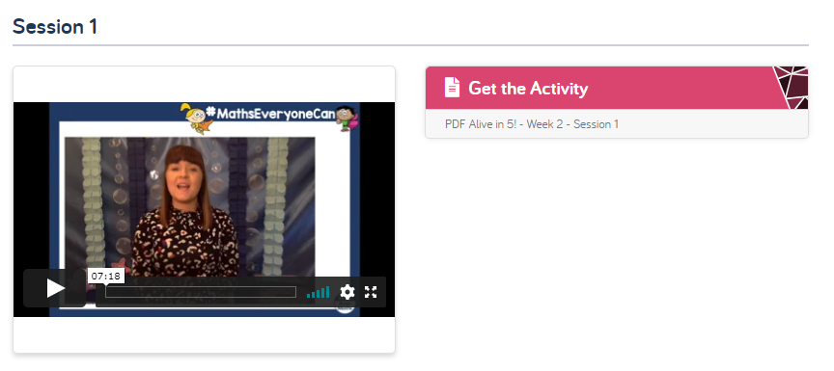
Session 1 Lesson Objective: To explore and compare the composition of numbers to 5.
Activity:
Please open up the website link below for White Rose Maths.
https://whiterosemaths.com/homelearning/early-years/alive-in-5-week-2/
- Watch the ‘Session 1’ video and open the PDF for the activity to follow.
For the activity…
For the video…

Slide 3
Session 1 Lesson Objective: To explore and compare the composition of numbers to 5.

Slide 4
Subject: Maths Year Group: Reception Week Commencing: Monday 11th January
For subject information, games and activities to support this planning, please also look on our class blog for anything phonics, reading and writing related

Slide 5
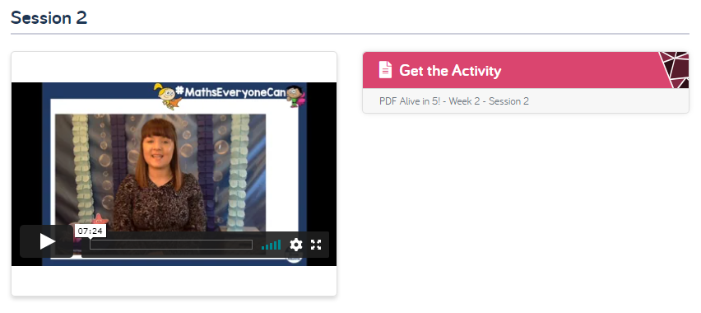
Session 2 Lesson Objective: To explore and compare the composition of numbers to 5.
Activity:
Please open up the website link below for White Rose Maths.
https://whiterosemaths.com/homelearning/early-years/alive-in-5-week-2/
- Watch the ‘Session 2’ video and open the PDF for the activity to follow.
For the activity…
For the video…

Slide 6
Session 2 Lesson Objective: To explore and compare the composition of numbers to 5.

Slide 7
Subject: Maths Year Group: Reception Week Commencing: Monday 11th January
For subject information, games and activities to support this planning, please also look on our class blog for anything phonics, reading and writing related

Slide 8
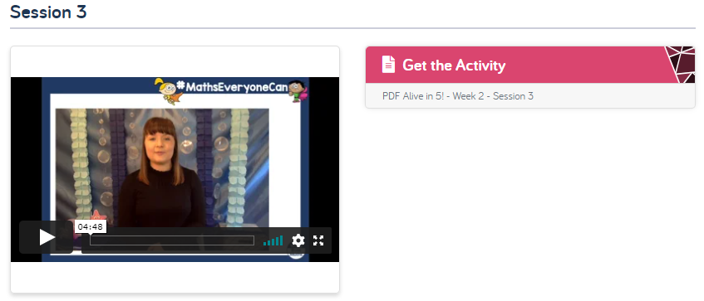
Session 3 Lesson Objective: To explore and compare the composition of numbers to 5.
Activity:
Please open up the website link below for White Rose Maths.
https://whiterosemaths.com/homelearning/early-years/alive-in-5-week-2/
- Watch the ‘Session 3’ video and open the PDF for the activity to follow.
For the activity…
For the video…

Slide 9
Session 3 Lesson Objective: To explore and compare the composition of numbers to 5.

Slide 10
Subject: Maths Year Group: Reception Week Commencing: Monday 11th January
For subject information, games and activities to support this planning, please also look on our class blog for anything phonics, reading and writing related

Slide 11
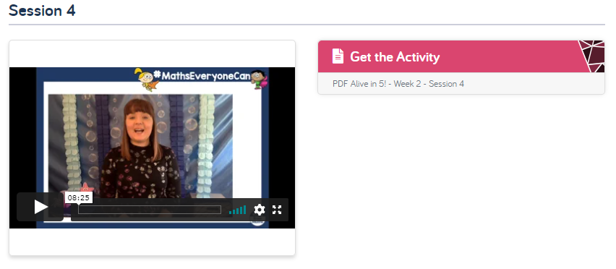
Session 4 Lesson Objective: To explore and compare the composition of numbers to 5.
Activity:
Please open up the website link below for White Rose Maths.
https://whiterosemaths.com/homelearning/early-years/alive-in-5-week-2/
- Watch the ‘Session 4’ video and open the PDF for the activity to follow.
For the activity…
For the video…

Slide 12
Session 4 Lesson Objective: To explore and compare the composition of numbers to 5.

Slide 13
Subject: Maths Year Group: Reception Week Commencing: Monday 11th January
For subject information, games and activities to support this planning, please also look on our class blog for anything phonics, reading and writing related

Slide 14
Session 5 Lesson Objective: To explore and compare the composition of numbers to 5.
Activity:
Please open up the website link below for White Rose Maths.
https://whiterosemaths.com/homelearning/early-years/alive-in-5-week-2/
- Watch the ‘Session 5’ video and open the PDF for the activity to follow.
For the activity…
For the video…

Slide 15
Session 5 Lesson Objective: To explore and compare the composition of numbers to 5.

