Slide 1
Subject: Phonics Year Group: Reception Week Commencing:18/1/21
For subject information, games and activities to support this planning, please also look on the ‘Help your child with English’ document saved on the class page.

Slide 2
Date: 18/1/21

Slide 3
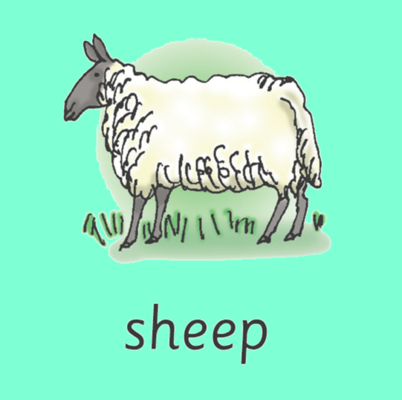
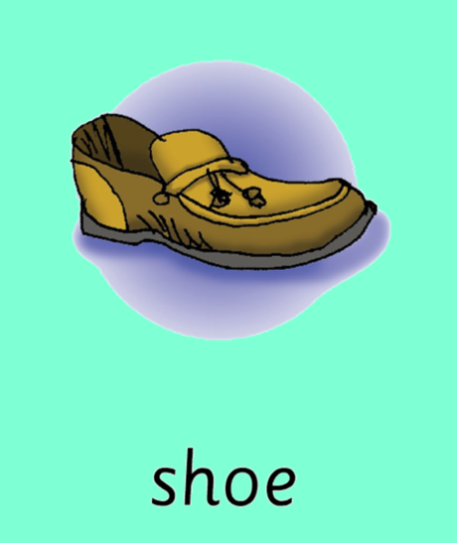
We can find this digraph at the beginning, middle and end of words. Can you think of any of your own words that have this digraph in?

Slide 4
Is it a real or nonsense word? Read the words and decide!
ship
shuff
shap
hush
shop
fish
shell
posh

Slide 5
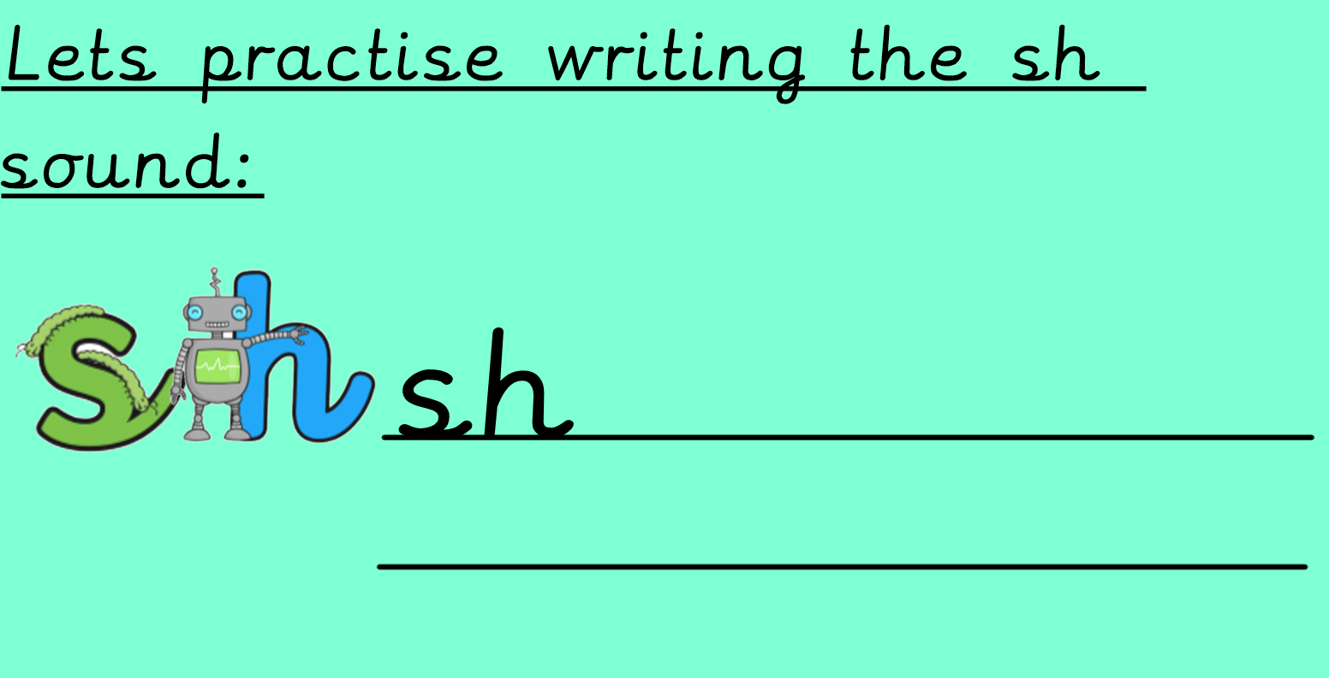

Slide 6
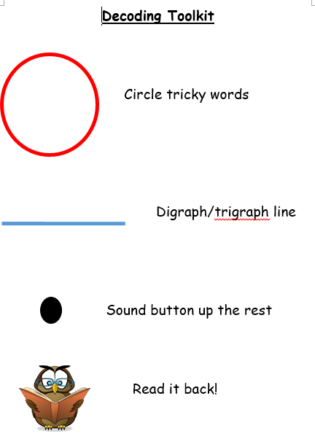
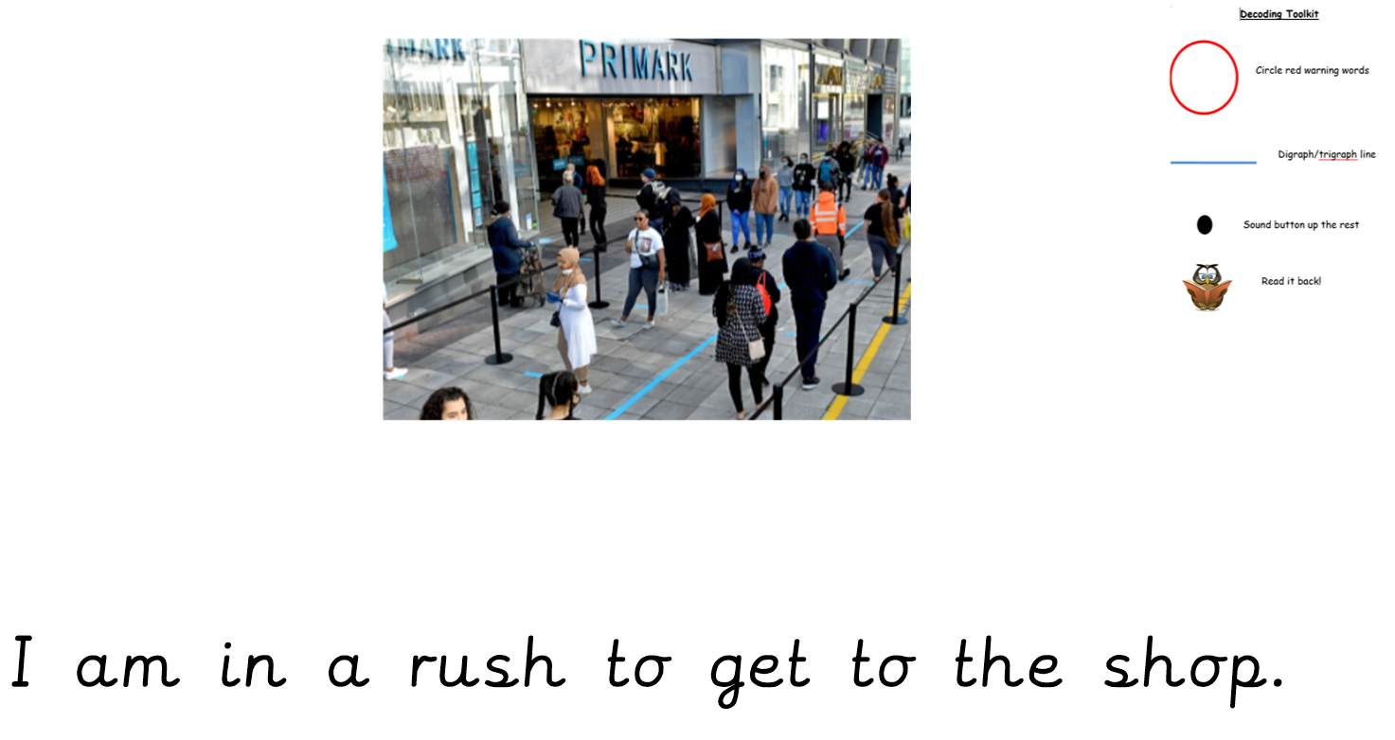
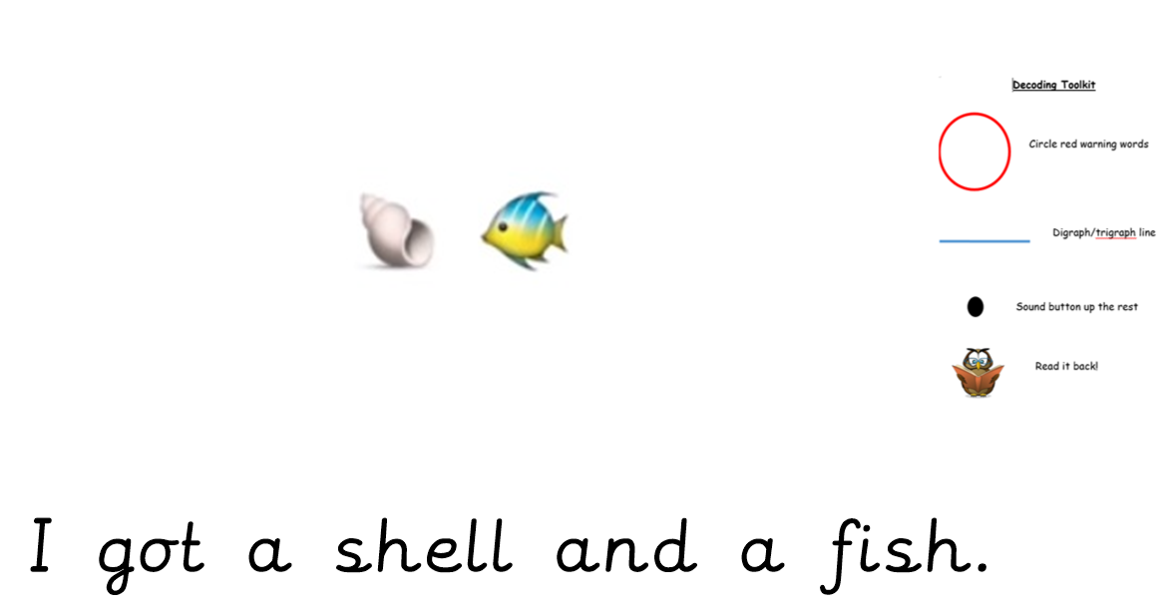
Sentence reading time!
Ask an adult to write these sentences down and then use the decoding toolkit to read them.

Slide 7
Subject: Phonics Year Group: Reception Week Commencing: 18/1/21
For subject information, games and activities to support this planning, please also look on the ‘Help your child with English’ document saved on the class page.

Slide 8
Date: 19/1/21

Slide 9
What words do we already know that have this sound at the beginning? Can you think of any of your own words?
cheese
church
cherry

Slide 10
Let’s practice using the digraph ch…….
Can you blend the words……
chip chat chick chin

Slide 11
Is it a real or nonsense word? Read the words and decide!
sach
chip
chap
chat
chop
chum
chin
bach

Slide 12
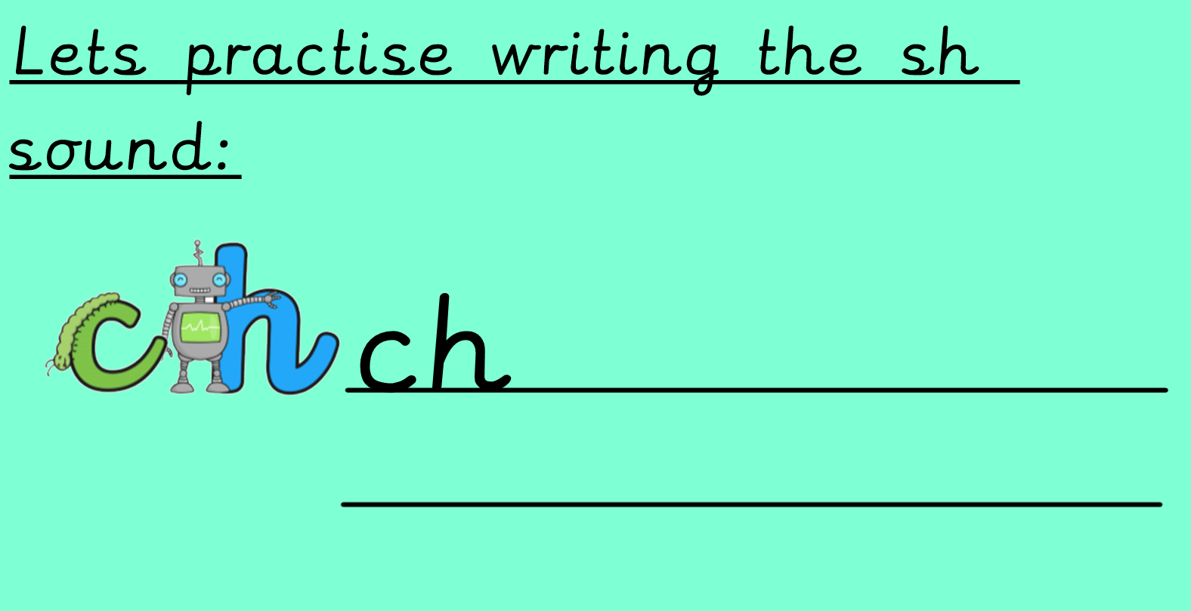

Slide 13
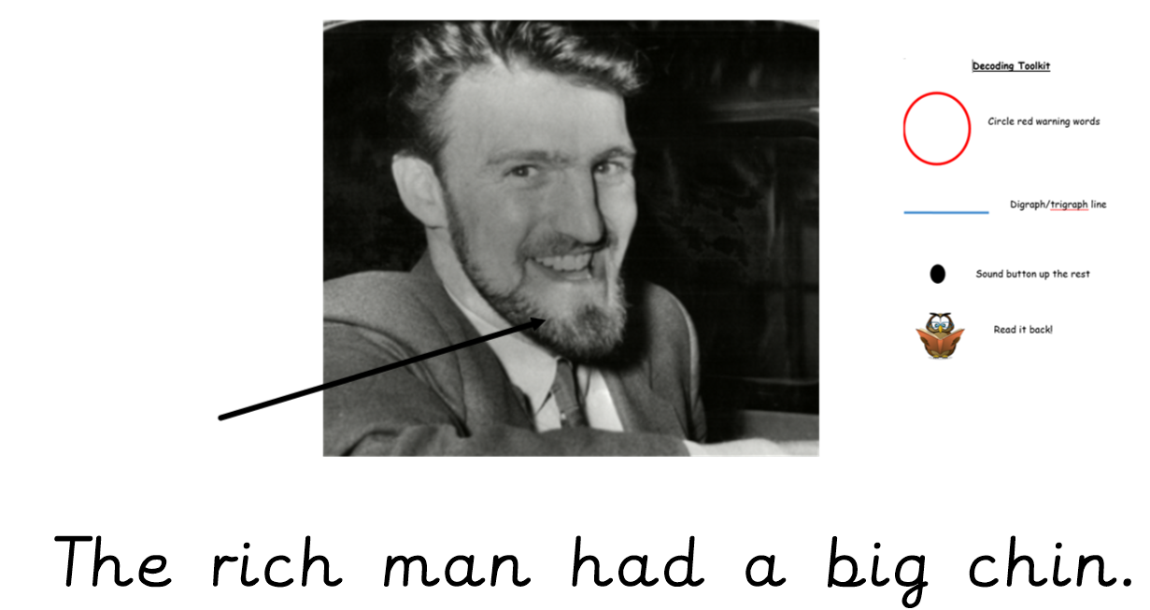
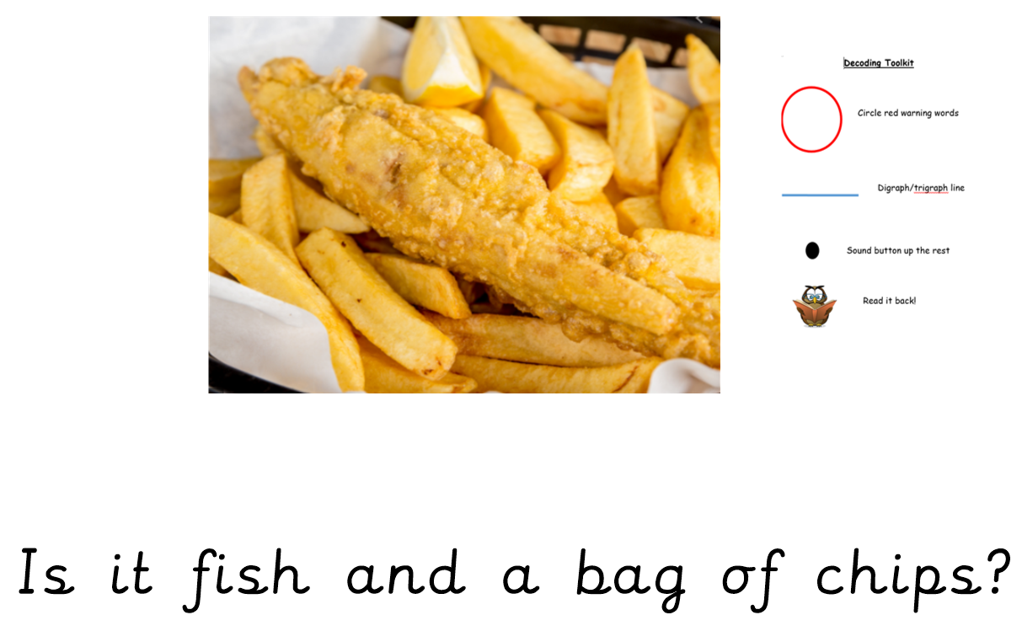
Sentence reading time!
Ask an adult to write these sentences down and then use the decoding toolkit to read them.

Slide 14
Subject: Phonics Year Group: Reception Week Commencing: 18/1/21
For subject information, games and activities to support this planning, please also look on the ‘Help your child with English’ document saved on the class page.

Slide 15
Date: 20/1/21

Slide 16
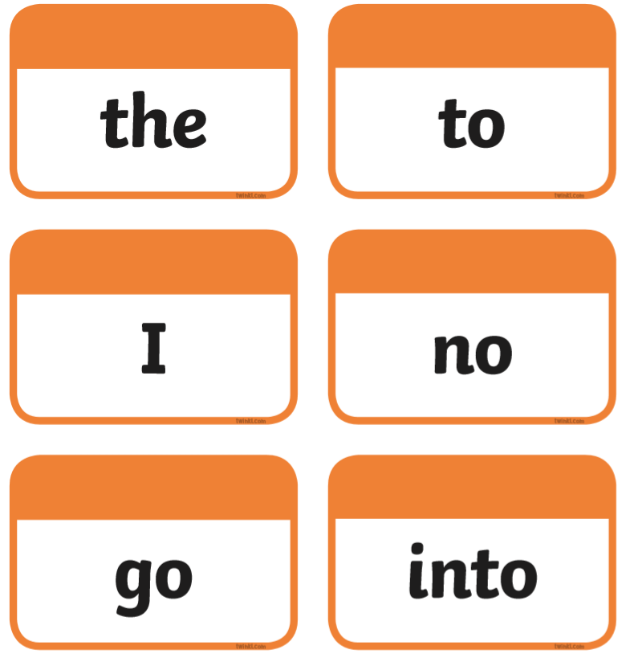
Let’s recap the tricky words we have learnt so far….

Slide 17
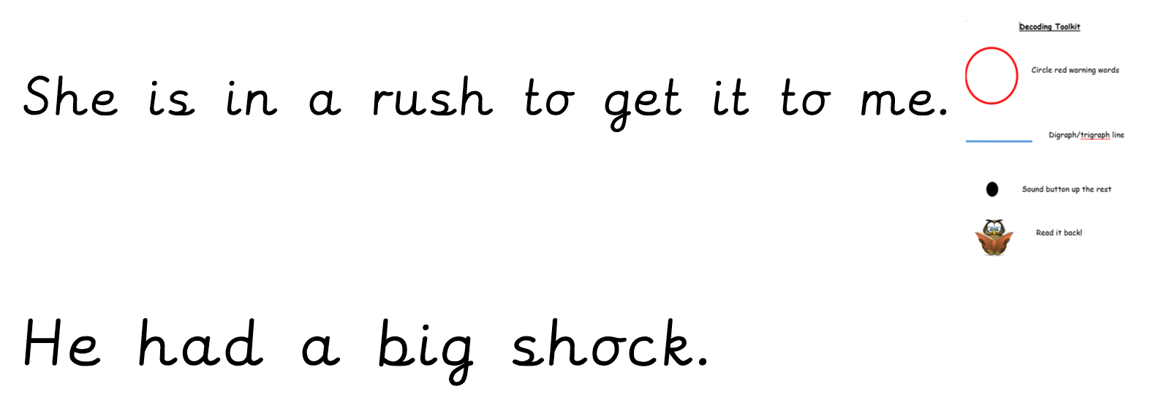

Slide 18
Subject: Phonics Year Group: Reception Week Commencing: 18/1/21
For subject information, games and activities to support this planning, please also look on the ‘Help your child with English’ document saved on the class page.

Slide 19
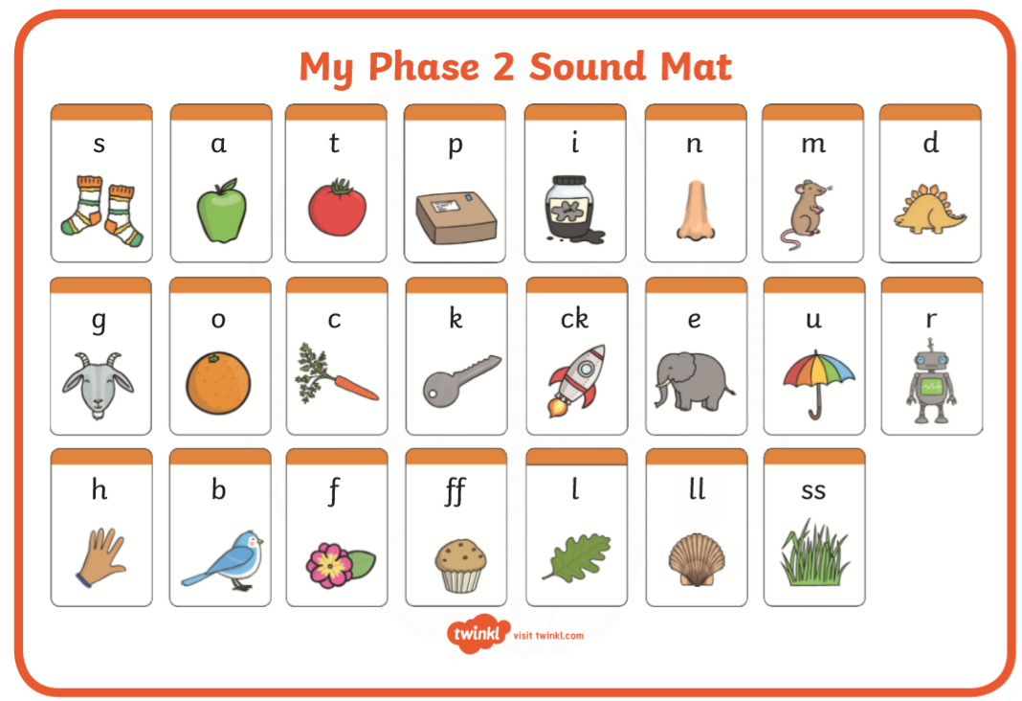
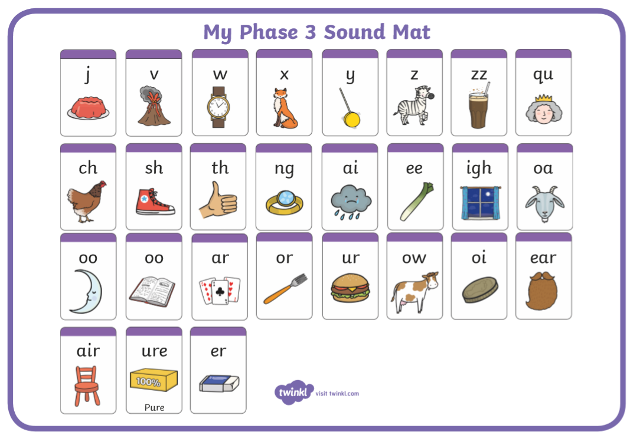
Date: 21/1/21
Today we are recapping the digraph sh.
Let’s recap all of the sounds we have learnt so far……

Slide 20
Let’s recap all the tricky words we have learnt so far…..

Slide 21
Let’s recap this digraph….
Can you spot the digraph in this words?
ship
shop
fish
posh
What sound does this make?

Slide 22
Can you
decode
these
words?

Slide 23
Access the ‘sh recap’ video on Tapestry
for your writing activity!

Slide 24
Subject: Phonics Year Group: Reception Week Commencing: 18/1/21
For subject information, games and activities to support this planning, please also look on the ‘Help your child with English’ document saved on the class page.

Slide 25
Date: 22/1/21
Today we are recapping the digraph ch.
Let’s recap all of the sounds we have learnt so far……

Slide 26
Let’s recap all the tricky words we have learnt so far…..

Slide 27
Let’s recap this digraph….
Can you spot the digraph in this words?
chip
chop
chest
much
What sound does this make?

Slide 28
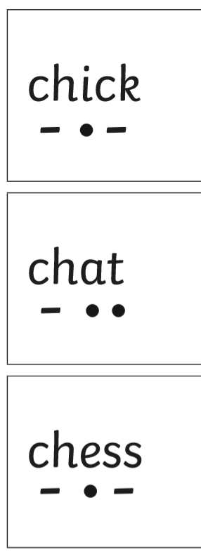
Can you
decode
these
words?

Slide 29
Access the ‘ch recap’ video on Tapestry
for your writing activity!

