Slide 1
Welcome to Key Stage 2!
Year 3 2021-2022

Slide 2
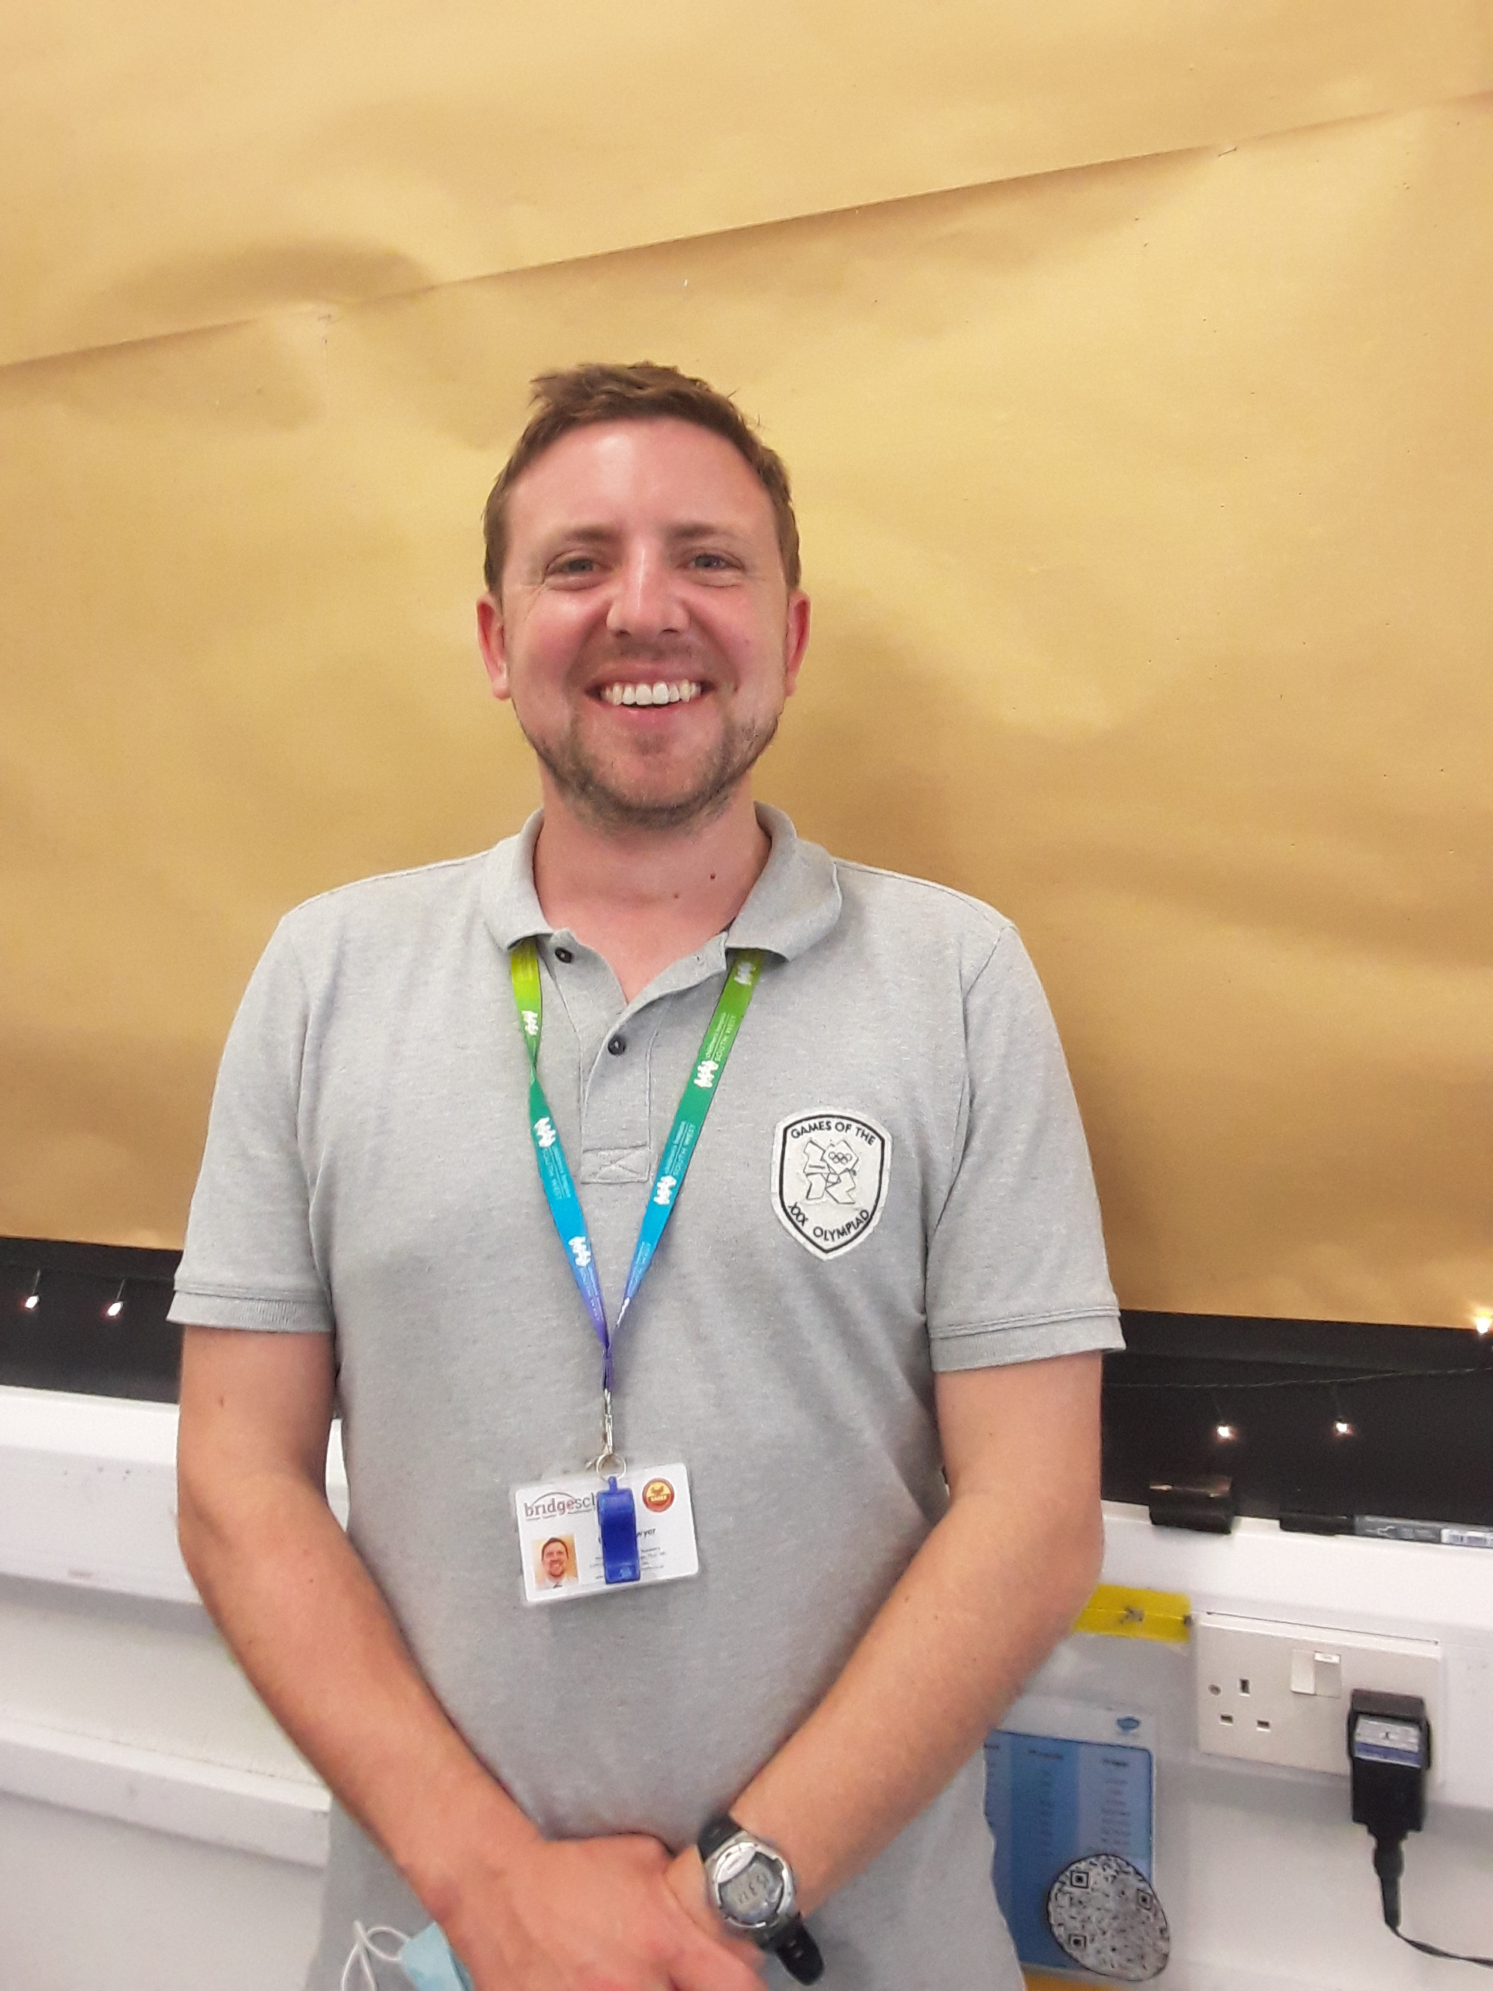
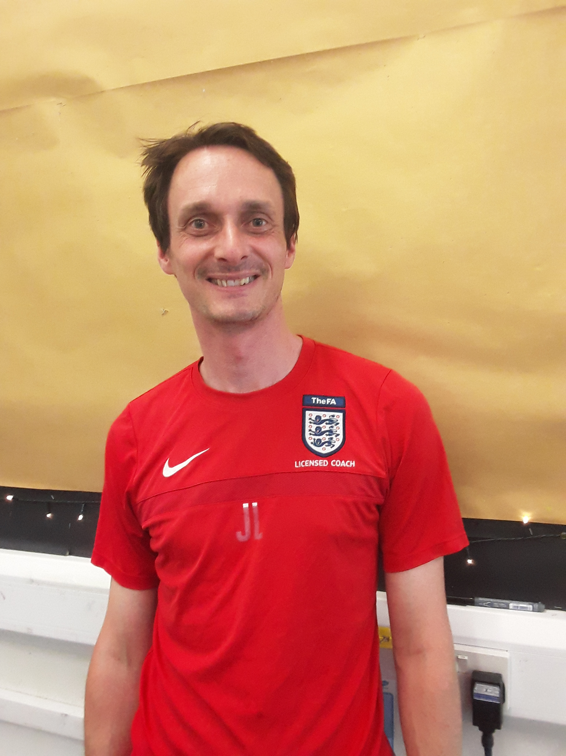
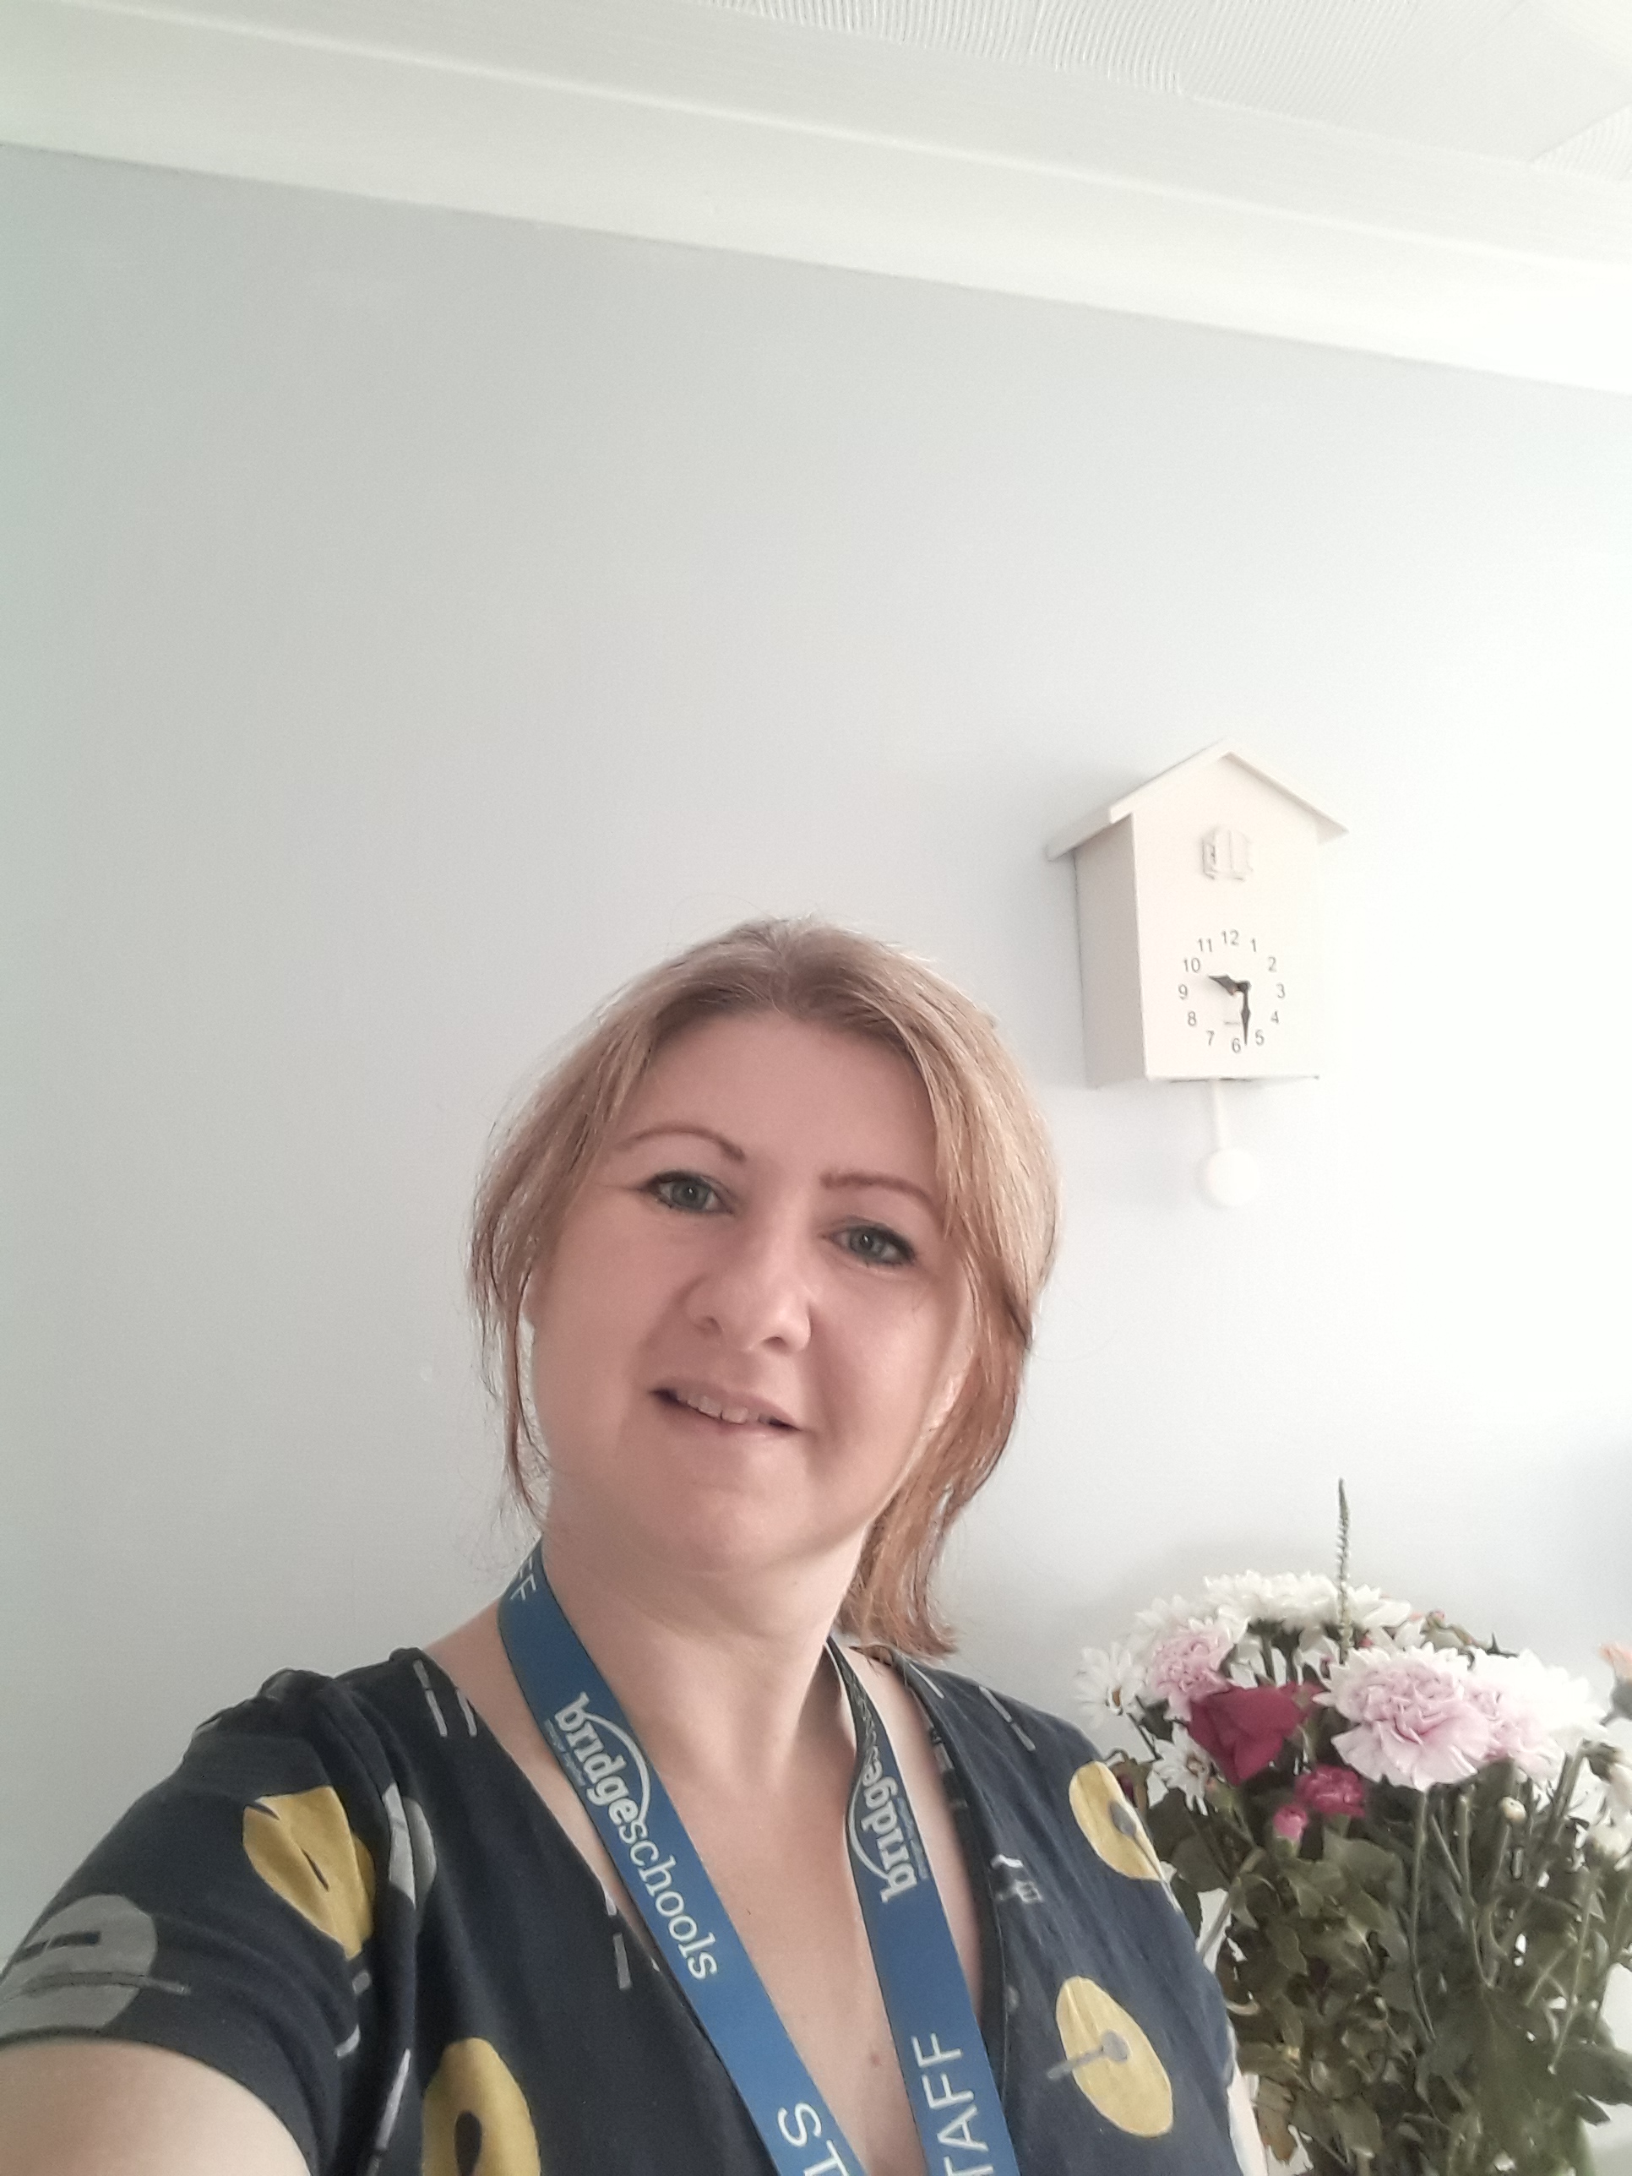
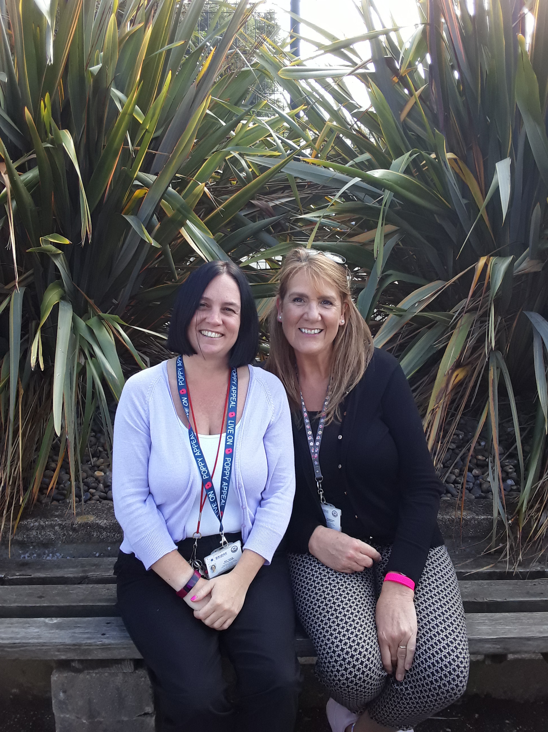
Our Year 3 Team
3W
Mr O’Dwyer
lodwyer@wadebridgeprimary.co.uk
3B
Mr Langton & Mrs Hill
(Monday – Wednesday) (Wednesday - Friday)
jlangton@wadebridgeprimary.co.uk
sjhill@wadebridgeprimary.co.uk
TAs
Mrs Hodkinson (3W)
&
Mrs Young
(3B am and across Y3 pm)

Slide 3
Topics covered:
Timings of the day
Learning in Year 3
Reading
Home learning
Meals, snacks and drinks
Pupil Premium/Free School Meals
Communication
Questions

Slide 4
The School Day
School will start at 8.40am and finish at 2.50pm This is slightly longer than the children will be used to!
Children will come in to school via the green gate leading to the Key Stage 2 classrooms which opens at 8.25am. Children will enter the cloakroom where they will hang their belongings and wash their hands before entering the classroom (there is a shelf on which they can place their lunch boxes and drinks bottles).
Break will be at 10.30 when children will be able to have a drink and a snack as well as a play in the Year 3/4 playground.
Lunch will be at 12.15 and last for 45 minutes.
Children will leave school via the green gate at 2.50pm.

Slide 5
Learning in Year 3
Just like in Key Stage 1, we will have topics during which we will do lots of our wider curriculum learning.
Our first topic question will be:
"Did Cavemen Spearhead the way for Modern Day Life?"
where we will be looking at life during the Stone Age, Bronze Age and Iron Age up until the Roman invasion.
Our Reading and Writing will be linked to our topic. We will be writing stories and instructions.
Maths will continue in the same way as KS1.
In Key Stage 2, we start learning a new subject: French!
There will be six topics to study in RE throughout the year, just as in Year 2.
Notes:
SJ

Slide 6
Reading
Reading continues to be a vital part of your child’s learning and so reading at home with them regularly will help to ensure continuing progress developing fluency, vocabulary and understanding. Little and often is best.
Your child will be given a banded school reading book to ensure correct pitch for development of reading skills. Reading books will be changed as and when needed and in order to develop children’s independence, we encourage them to take ownership of alerting a member of staff when they need to change their book. Staff will be on hand to guide children to ensure they select the correct level of text as well as encouraging them to explore a range of different texts within that band.
In order to promote a love of reading, children will be visiting the school library once a week (on a Monday) where they can choose any book they wish.
As with Key Stage One, we continue to use our Reading VIPERS to help children develop skills of comprehension. This becomes increasingly important in Key Stage Two.
We will listen to every child read at least once a week, every week throughout the year so please ensure that children continue to bring in their Reading Packets daily. Staff will initial in Reading Records to show that they have heard your child read. Detailed individual comments will be kept in school to help with assessment.
If you have any concerns or would like more information about your child’s reading, please do not hesitate to contact your child’s teacher.
Notes:
We recognise the important impact home learning has upon children’s progress as well as providing an important link between home and school. The Education Endowment Foundation has researched the impact of home learning upon children’s progress and on the whole, this has an increase rate of two months’. This means that children should make an additional two months’ progress by completing home learning tasks regularly.

Slide 7
Home Learning
Teaching and Learning Toolkit | Education Endowment Foundation | EEF
In Year 3, we will send home a piece of homework each week, alternating between English and Maths. This will be sent home on a Friday and should be returned by the following Friday. Work sent home will support learning completed in class so please take the time to go through this with your
In addition to this, children will be having weekly spelling tests; word lists will be sent home every Thursday. Please take the time to look over these with your child in order to ensure that their spelling fluency and accuracy improves, a key focus in Key Stage Two writing. If your child participates in Nessy, please use this app to help close gaps in their learning.
Times Tables; children will be required to take part in statutory assessments at the end of Year 4. With this in mind, we make a start early by conducting weekly tables assessments. The best way to learn tables is by chanting them repeatedly – honestly, it works! Times Tables Rock Stars is an online platform which can be used to support learning in maths. Login details for this can be found in your child’s Reading Record.
Optional Topic Learning grids will also be available each term which will give children an opportunity to be a little more creative with their learning; it could be that children decide to bake something topic-related or do some research, draw a picture or create a collage.
Details of all home learning will be available on our website.
Notes:
We recognise the important impact home learning has upon children’s progress as well as providing an important link between home and school. The Education Endowment Foundation has researched the impact of home learning upon children’s progress and on the whole, this has an increase rate of two months’. This means that children should make an additional two months’ progress by completing home learning tasks regularly.

Slide 8
Meals, snacks and drinks
Children are no longer entitled to a free school meal as they have been in Key Stage 1. However, they are still able to have a school meal which can be paid for in advance via ParentPay: ParentPay - The Leading Cashless Payments System for Schools. Meals cost £2.49. Children who are entitled to Free School Meals will not be charged for a school meal. You can apply for Free School Meals via this link: School meals - Cornwall Council
The school dinner menu can be found on the school website in the Information tab. There is always a meat and vegetarian option. In addition to this, there is a Jacket Potato option. If your child has any dietary requirements, please speak to a member of staff who will be more than happy to assist you.
You will also need to send a snack in to school with your child for morning play. However, please consider the snack choices carefully as we are part of the Healthy Schools initiative and so any snack you send in with your child should be fresh fruit or vegetables. Fruit winders/cereal bars do not count as a healthy snack. We would also like to remind you that we are a nut-free school so any snacks that contain nuts are not permitted. If you have any problems, please speak to a member of the team.
As with Year 2, please continue to send your child in to school with water in a named bottle.
Notes:
If you require any assistance with your ParentPay account, please contact a member of our admin team.

Slide 9
Communication
Pop and see us at the end of the day when you collect your child,
Check out the Year 3 webpage on the school website,
Request a telephone appointment,
Email us directly
Weekly Head’s Blog
Texts & emails from school with important updates.
Adult on Key Stage 2 gate daily to take messages.

Slide 10
Do you have any questions for us?
We are so proud of how smart the children are and how well they have settled in to their new classes – thank you so much!
We are very much looking forward to the year ahead and working with you to help each and every child grow ☺

